Slide 1
Nanotechnology Summary

Slide 2
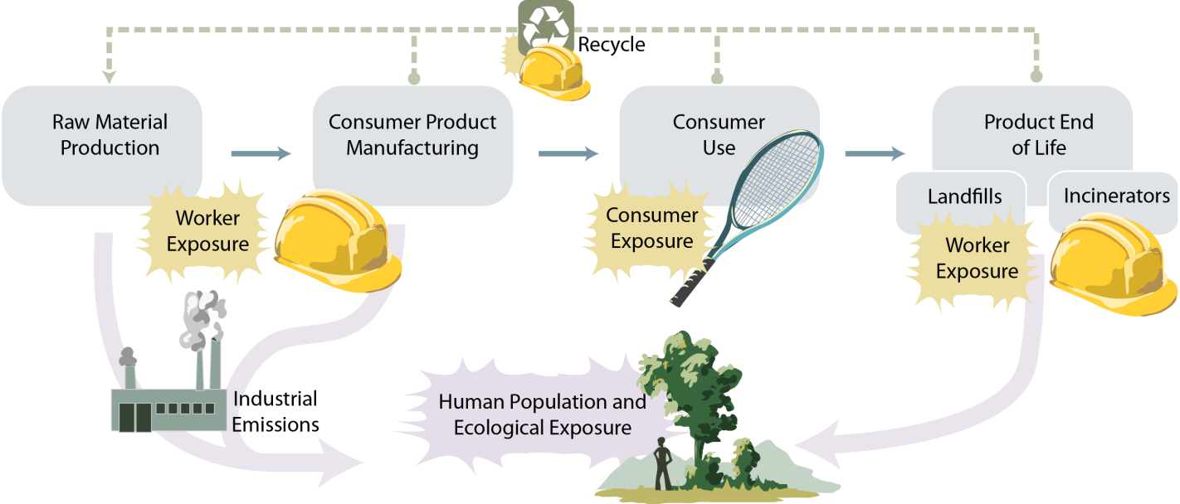
Potential Worker Exposures

Slide 3
Overview
Early in history
Cannot be sequential in process
Preliminary positive hazard data
  Heterogeneity of hazards

Slide 4
Gaps
Knowledge
Legislation
Guidance
Application of guidance

Slide 5
Proposed Overarching Principle
The health of workers should not be undermined by their work with nanomaterials

Slide 6
Proposed Overarching Principle
When workers handle nanomaterials, risk assessments must be performed and exposure limited to extent possible
If the risk is unknown strict precautions should be used to protect workers

Slide 7
Proposed Overarching Principle
Definitions
  Need to develop globally harmonized definitions for engineered nanomaterials

Slide 8
Proposed Overarching Principle
Transparency and traceability
  Manufacturers and down-stream users should ensure safety data sheets (SDS) contain the most correct information on nanomaterials
  Workers and employers must have access to all relevant the health and safety information regarding the nano-enabled products with which they work
      Should always include physico-chemical information and composition
      Should be included throughout the life-cycle of the material
  Develop international databases for types and uses of nanomaterials

Slide 9
Proposed Overarching Principle
Sustainability and life-cycle approaches
  Emerging and enabling nanotechnology should apply “safe by design” principles to materials and processes to engineer out the hazardous or toxic potentials of new engineered nanomaterials as a best practice to protect workers and the environment

Slide 10
Proposed Overarching Principle
Well-established Industrial Hygiene methodologies can be utilized efficiently for nanomaterials risk management
  Continue to refine and improve methodologies as more information becomes available

Slide 11
Proposed Overarching Principle
Develop early warning systems to monitor workers health
  Expand research on potential health effects
    Toxicology
    Epidemiology
  Need for harmonized parameters for medical monitoring
    Include appropriate record keeping

Slide 12
Proposed Overarching Principle
In case exposure limit values are not available for specific nanomaterials a precautionary approach should be applied
  Generic nano reference values should be considered as a tool for setting provisional limits

Slide 13
Proposed Overarching Principle
Develop harmonized exposure assessment measurements and control strategies for nanomaterials and processes
    Process generated nanomaterials cannot be ignored when assessing nanomaterials at the workplace

Slide 14
Proposed Overarching Principle
Workers have the right to participate in developing risk management practices involving nanomaterials in the workplace
  Requires specific training in hazard identification and best practices

Slide 15
Recommendations
Incorporate principles in laws, regulations, practices
Promote sector-specific assessments of exposure potential
Promote further investigation of hazard potential and comparative potency
Develop joint database on control solutions
Develop joint website for workers

