Slide 1
Can Control Banding be Useful to Ensure Adequate Controls for Safe Handling of Nanomaterials?
A Systematic Review
Adrienne C. Eastlake, MS, RS/REHS
Ralph Zumwalde, MS, CIH
National Institute for Occupational Safety & Health
June 3, 2015
The findings and conclusions in this presentation have not been formally disseminated by the National Institute for Occupational Safety and Health and should not be construed to represent any agency determination or policy.
Notes:
Today I would like to present data collected during a systematic review of literature to answer the question “Can control banding be useful to ensure adequate controls for safe handling of nanomaterials?”

Slide 2
Presentation Overview
Background
  Who is NIOSH?
  What is control banding?
  Why is CB of interest for use with nanomaterials?
Methods
  Systematic Review
Results
Conclusions
Notes:
During this presentation, I would like to address the following questions and provide you with an overview of the systematic review results and conclusions.
Before I get started, I would like to clarify who NIOSH is, provide a brief overview of control banding and why it may be of interest to those who are handling nanomaterials. Then we will jump into the systematic review.

Slide 3
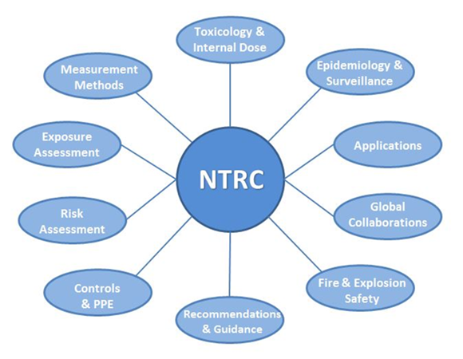
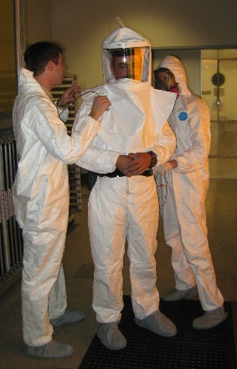
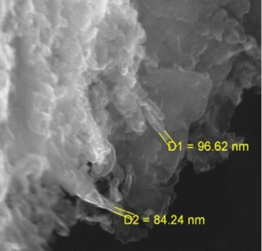
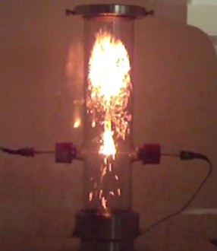
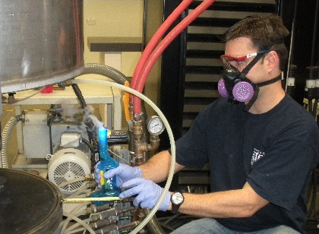
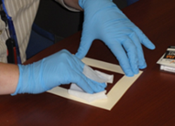
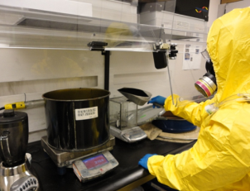
Who is NIOSH?
National Institute for Occupational Safety and Health (US)
  Nanotechnology Research Center (NTRC)
    Chartered in 2004
    Cross-Institute program – scientists from many different specialties
    10 Critical Research Areas
Notes:
For those of you that may not know, NIOSH is the National Institute for Occupational Safety and Health. The Nanotechnology Research Center was chartered in 2004 to look into and address potential worker health and safety issues surrounding the emergence of nano-sized materials. This cross institute program includes over 50 scientists from different specialties that are working in different cities, different buildings, and different areas of expertise on efforts that span our 10 critical research areas. Toxicology, Epidemiology, Applications, Global Collaborations, Fire & Explosion safety, Recommendations & Guidance, Engineering controls and PPE, Risk Assessment, Exposure Assessment, and measurement methods. As part of our strategic plan, we work to develop voluntary partnerships with nanotechnology companies, provide guidance to protect the workforce, and collaborate with other government agencies.

Slide 4

What is Control Banding?
Qualitative or semi-quantitative risk evaluation technique
Used to provide easy-to-understand and practical approaches for controlling exposures
Consists of the following key inputs:
Health Hazards (Risk Bands)
Exposure Potential (Exposure Bands)
Control Band
Notes:
So, what is Control Banding? Control banding is a qualitative or semi-quantitative risk evaluation technique that makes use of known data and previous knowledge to provide easy-to-understand and practical approaches for controlling exposures.
It takes into account the health hazards of the material – such as the material characteristics and toxicology
AND
The exposure potential – such as the duration of exposure, dustiness of the material, quantity of material.
All of this information then contributes to a control band.

Slide 5
What are Control Bands?
1-General Ventilation A good standard of general ventilation and good work practices.
2-Engineering Control Typically local exhaust ventilation, but also includes other types of engineering controls, but not containment.
3-Containment Completely contain or enclose the hazard, such as inside a glovebox.
4-Special Expert advice is needed in selecting appropriate control measures.
Notes:
A control band is where the method makes a recommendation as to how to best protect the worker based on the information input into the method. As you can see, these controls can range from general ventilation to containment or to seek expert advise.

Slide 6
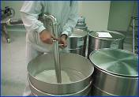
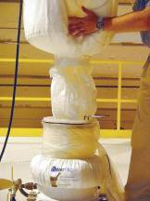
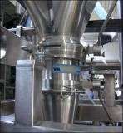
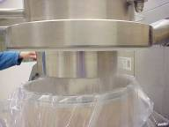
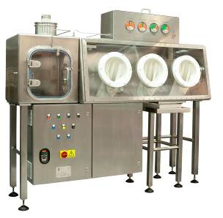
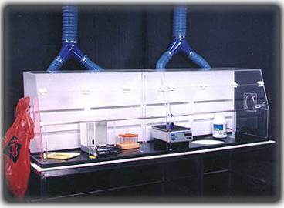
mild/reversible
Occupational Health Hazard
severe/irreversible
kilograms
8 hours
Exposure Risk
Closed Systems
Engineered Local Exhaust Ventilation
Task Duration
Quantity
milligrams
15 minutes
slurry/suspension
agglomerated
highly disperse
Physical Form
Special thanks to Donna Heidel, formerly of NIOSH
Notes:
6
This slide illustrates information on control bands, but in a slightly different way. As you can see, the exposure risk increases as the quantity of material and duration of exposure. But, it should also be noted that the exposure risk also increases as the physical form of the material becomes more easily dispersed and the potential for health effects increases. All of these factors play into the need for higher control over the material and therefore a higher control band.

Slide 7
Why is CB of interest specific to nanomaterials?
First, let me pose some questions…
How many OELs are you aware of that are specific to nanomaterials?
How do you quantify and identify the nanomaterial present in an occupational situation?
Do traditional engineering controls work to decrease the potential for exposure to nanomaterials?
Validated nanomaterial-specific control banding methods could provide a way to protect workers.
Notes:
So, the question then arises, why is control banding of interest when it comes to the handling of nanomaterials? First, let me pose some questions…
First, how many occupational exposure levels are you aware of that are specific to nanomaterials? Probably not many! NIOSH only has two, one for carbon nanotubes and fibers and one for titanium dioxide. With the number of new materials that are introduced is it feasible to create an OEL for each one?
Second, How do you quantify and identify the nanomaterial present in an occupational situation? Current methods integrate both direct reading instrumentation and filter-based samples to determine the presence and concentration of NMs. If there is no OEL, then how do you make use of this data? How can you expect a small business to make use of it?
Third, do traditional engineering controls work to decrease the potential for exposure to nanomaterials? Yes, it has been determined that ventilation and containment systems maintained at proper levels can decrease the potential for worker exposure.
Taking all of this information into account, it appears that traditional industrial hygiene methods may NOT be able to keep up with the increasing number and types of nanomaterials. It is because of this that validated nanomaterial-specific control banding methods could provide a way to protect workers.

Slide 8
Systematic Review
What is a systematic review?
  Method to assess and interpret a body of scientific information in response to a question of interest
  Steps involve the following:
    State and define problem/question of interest
    Identify and select relevant information
    Evaluate individual studies
    Extract and assess information across studies
    Provide and overall synthesis and interpretation of findings
Notes:
So, now that we have established the basics, let’s jump right into the systematic review.
For those of you that may not know, a systematic review is a methodology for assessing and interpreting a body of scientific information in response to a question of interest. Typically, it involves the following steps: stating a problem of interest, identifying and selecting the relevant information, evaluating individual studies, extracting and assessing information across studies, and providing an overall synthesis and interpretation of the findings.

Slide 9
Systematic Review Methods
Produced for the WHO Guideline Development Group
  Support “Protecting Workers from Potential Risks of Manufactured Nanomaterials”
  Just one of many different systematic reviews being performed internationally
  NIOSH addressed “Can Control Banding be Useful to Ensure Adequate Controls for Safe Handling of Nanomaterials
Notes:
This systematic review was produced at the request of the World Health Organization Guideline Development Group and will serve to support the development of the guideline document entitled “Protecting Workers from Potential Risks of Manufactured Nanomaterials.” A number of different systematic reviews are being performed internationally to answer many different nanomaterial specific questions over a wide range of topics – from typical exposure situations to health surveillance and exposure assessment techniques. The review performed by NIOSH focused on determining if control banding methods could be useful to ensure adequate controls for the safe handling of nanomaterials.

Slide 10
Systematic Review Methods
PRISMA Methodology used per WHO
  Identification of Literature
    Literature database search was performed on July 29, 2013
    16 different databases (such as PubMed, Toxline, Web of Science, etc.)
    PubMed search terms were as follows:
    (Occupational Exposure OR Occupational) AND (Control Band OR Control Bands OR Control Banding OR Exposure Band OR Exposure Bands OR Risk Banding OR Hazard Band OR Hazard Bands) AND English
Identification of Literature
  Two independent reviewers at each step
  Detailed notes were kept as to why records were excluded
    Titles of all records reviewed for relevance
    Complete article review was performed on remaining records
Notes:
As this systematic review was performed for the WHO, NIOSH followed terms of reference as defined by WHO. As this was the case we were required to use the Preferred Reporting Items for Systematic Reviews and Meta-Analyses (or PRISMA) method for this systematic review.
A total of two review authors were involved in the evaluation of this question. After discussion of the question, we determined that studies that applied control banding methods to the use/handling of nanomaterials would provide the answer. Based on this question, we worked to determine database searches that would provide literature that would address our question.
Our literature database search was performed on July 29, 2013 and spanned 16 different databases. An example of the search terms used for PubMed is listed here, but there is a complete list of the different search terms used specific to each database that is NOT shown.
After a complete list of literature was obtained, the review process began. At each step of the process, the two independent reviewers performed each step and documentation was kept as to why particular records were included or excluded. Both for title and full article review, records were excluded if they were a not a peer-reviewed article or if they did not apply control banding methods specifically to nanomaterials. All reasons for exclusion were documented..

Slide 11
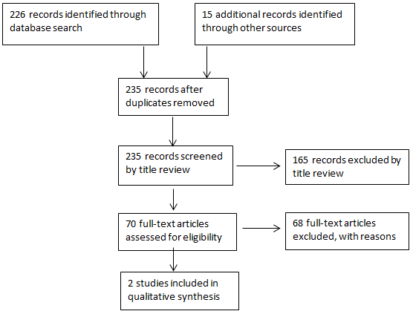
Results
PRISMA flow diagram showing study selection process
Notes:
Here is a PRISMA flow diagram showing our documented study selection process.
As you can see, we started with over 200 records and through the PRISMA process, we identified a total of 2 studies that applied control banding methods to the handling and use of nanomaterials.

Slide 12
Systematic Review Methods
  Methodological Index for Non-Randomized Studies (MINORS) checklist was completed on each included record
      Results summarized as risk of bias profiles
      Score obtained on each study to determine quality of the studies
  Grading of Recommendations Assessment, Development and Evaluation (GRADE)
      Used to determine overall quality of the evidence
Notes:
Once the relevant articles were identified, MINORS was used to determine the quality of the studies and GRADE was used to evaluate the overall quality of the evidence.

Slide 13
Control Banding Nanotool
Requires calculation of a Severity and Probability score by answering questions about the bulk and the nanomaterial.
Severity Score: Out of 100 points
  70 based on characteristics of the nanomaterial and 30 based on characteristics of the parent material
Probability Score: Out of 100 points
  Determine the extent which employees may be exposed to nanoscale materials
    Examples: amount used during task, dustiness/mistiness, number of employees with similar exposure, frequency of operation, and operation duration
Risk level is determined using both Severity and Probability Scores.
Source: Paik S, Zalk D, Swuste P. 2008. Application of a Pilot Control Banding Tool for Risk Level Assessment and Control of Nanoparticle Exposures. Ann Occup Hyg. 52(6):419-428.
Notes:
Of the two studies that applied control banding methods to nanomaterial exposures, both made use of the CB nanotool. These studies compared the recommended engineering control results of the CB nanotool evaluation with those of an experienced industrial hygienist. This slide shows some of the specifics of the CB nanotool method.
As you can see, it is a point-based method. The user answers a series of questions and each answer provides a certain number of points. Two different categories are scored: one that is based on the characteristics of the nano and parent material and the other is based on the extent which an employee may be exposed to the material.

Slide 14
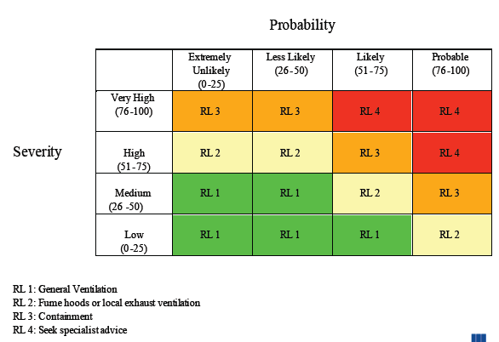
Control Banding Nanotool Matrix
Notes:
The scores from each category are then used within this matrix to indicate the risk level (one through four) which then corresponds to a recommended control.

Slide 15
Results
Source | Number of activities evaluated | Number of task engineering controls consistent with what was recommended by the CB Nanotool
Paik, Zalk, & Swuste, 2008 | 5 | Three out of five were consistent with those recommended by the tool One task was determined to need upgrading One task’s current controls exceeded what was recommended by the tool
Zalk, Paik, & Swuste, 2009 | 27 | 16 out of 27 controls were consistent with those recommended by the tool 8 out of 27 controls were determined to need upgrading Three of the tasks’ current controls exceeded what was recommended by the tool
Summary of studies applying control banding to the use and/or handling of nanomaterials – 2 studies with 32 tasks
Notes:
Within the two studies identified, there were a total of 32 tasks evaluated.
This table summarizes the results of all tasks within the studies. It indicates the number of task engineering controls that were consistent with what was recommended by the CB nanotool.
Based on the data in this table, 19 out of 32 tasks already had adequate controls
9 tasks needed control upgrades
and in 4 tasks the current controls exceeded what was recommended by the CB nanotool

Slide 16
Results
Type of Task | CB Nanotool recommended upgrading the current exposure controls
 | Total | Yes | No | % to upgrade
Synthesis or growth of material | 9 | 1 | 8 | 11%
Sample preparation | 8 | 3 | 5 | 37.5%
Product mixing or manipulation | 11 | 1 | 10 | 9%
Waste handling | 4 | 4 | 0 | 100%
Summary of the CB Nanotool recommended upgrades based on task type
Notes:
When all 32 job activities are consolidated into four categories, differences in exposure controls recommended using professional judgement by the industrial hygienist and those recommended using CB Nanotool can be compared. For example when you look at this table you can see where use of the CB Nanotool appears to recommend a conservative exposure control when handling nanomaterial waste – indicated here by a high “percent to upgrade”.

Slide 17
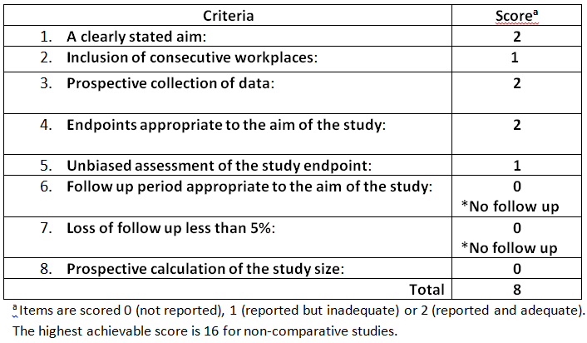
Results – MINORS
MINORS evaluation – indicating 8 out of possible 16 points for each study (example at right) – indicating a high risk of bias for determining usefulness of CB with NMs
Notes:
As indicated earlier, both MINORS and GRADE were used to evaluate the quality of the evidence and the risk of bias in this systematic review.
Here you see results for the MINORS method for only one study. Each study was scored based on the 8 different criteria listed in this table. The total evidence criteria scores were consistent between the two studies with both achieving a total score of 8 out of a possible 16. This score indicates that both of the studies were at a high risk of bias for determining the usefulness of CB in controlling exposure to nanomaterials.

Slide 18
Results – GRADE
GRADE evaluation – indicated very low quality of evidence
Comparison | Risk of Bias | Consistency | Directness | Precision | Publication Bias | GRADE Quality
CB versus Industrial Hygienist | Two high risk observational studies: Downgrading | All results consistent: No downgrading | Direct comparison: No downgrading | Total number of activities (32): Downgrading | Not detected in Review: No downgrading | Very Low Quality
Notes:
The results using the GRADE method are presented in this table. Again, this method was used to determine the risk of bias within the included studies. After evaluating the studies using this method, the overall quality of the evidence conforming to the GRADE approach resulted in a rating of very low quality of evidence.

Slide 19
Conclusions
Based on the results of this review, NIOSH has concluded:
  There is currently a lack of evidence to conclude that nanospecific CB tools lead to adequate exposure controls. *
  Additional validation work is needed to support the exclusive use of CB for the safe handling of NMs
  *As of July 29, 2013 when this literature review was performed.
Notes:
So, in conclusion, this review determined that the studies reviewed were at a high risk of bias for determining the usefulness of CB in controlling exposure to nanomaterials and that there was a very low quality of evidence presented in the papers reviewed. Based on the results of this review process, NIOSH has determined that there is currently a lack of evidence to conclude that nanospecific control banding tools lead to adequate exposure controls. In addition, a key takeaway is that additional research and published validation work is needed to support the use of control banding for the safe handling of nanomaterials.

Slide 20


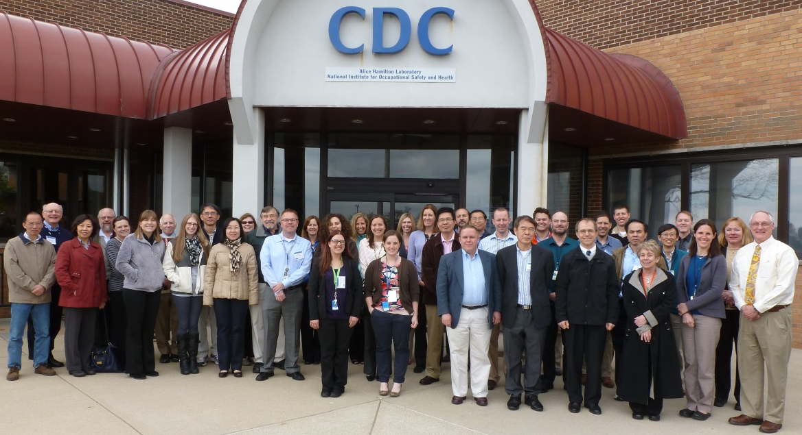


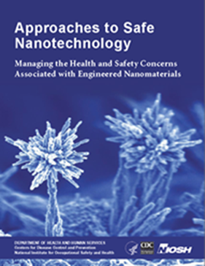

The NIOSH Nanotechnology Research Center
Thank you!
Adrienne Eastlake
aeastlake@cdc.gov
Notes:
And with that, I will open it up for questions.

