Slide 1
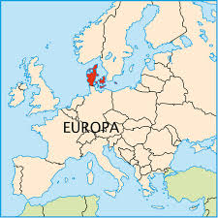
Population:
5.600.000
Labor:
3.000.000

Slide 2
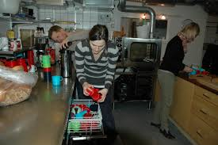
Adressing work related psychosocial risks:
A tripartite approach
1. Psycosocial risks
2. Labor market in Denmark
3. Legislation and strategies in DK
4. Tripartite agreements
5. Considerations and conclusions

Slide 3
Psychosocial risk
European social partners Framework Agreement on Work-related stress:
Definition on work related stress: ‘
A state, which is accompanied by physical, psychological or social complaints
or dysfunctions and which results from individuals feeling unable to bridge a
gap with the requirements or expectations placed on them
‘Stress is not a disease but prolonged exposure to it may reduce effectiveness
at work and may cause ill-health’

Slide 4

Psychosocial risks is an integrated part of European legislation
Framework directive 89/391
Article 5
General provision
1. The employer shall have a duty to ensure the safety and health
of workers in every aspect related to the work.

Slide 5



Psychosocial risks
Different national implementation in the EU
Belgian legislation on psycochosial risks:
Employers have to take specific measures to keep psychosocial risks
under control. As part of the general prescribed management approach
to tackling health and safety issues, companies have to draw up a
five-yearly global prevention plan, a yearly action plan and a yearly
report on the internal system for prevention and protection at work.
UK:
Management standard for work-related stress:
http://www.hse.gov.uk/pubns/indg430.pdf
DK:
‘This Act shall cover the physical and psychological working environment.’

Slide 6
Psychosocial risk – a few facts
50 – 60 % of all lost working days can be attributed to work-related stress and psychosocial risks.
In Europe 25 % of all workers says that they experience work-related stress all or most of the time.
80 % of managers in Europe express a concern about work-related stress.
In DK 68 % of managers (mainly public) only to some or to a very small degree felt prepared to tackle employees with work-related stress.
The Danish Institute for Public Health has estimated, that 1400 danish workers die every year as the result work-related psychosocial risks

Slide 7
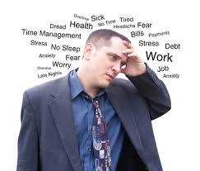
Is stress really work-related ?
Danish survey on ”Working Environment and Health”. Survey performed every second year
27.000 respondents – a liltte less than 1 % of labour
One of the questions is: “How often have you felt stressed in the last 2 weeks”
Answer categories: never, seldom, sometimes, often or always.
25 % answered never. 14.5 % of the cohort answered often or always
The 75 % with yes to stress were then asked what have caused the stress, work, private life or both. The answer was that 67 % said work is the main source for stress.
Amongst the 14.5 % only 10 % answered private life (43 % work and 47 % both)

Slide 8

https://osha.europa.eu/en/publications/reports/psychosocial-risks-eu-prevalence-strategies-prevention/view

Slide 9

The situation in Denmark
Settlement of the Danish ‘Main Agreement’
in 1899. Establish the right to take indu-
strial action for a collective agreement,
recognizing leadership right and
the duty not to strike, when you have one
The social partners manage Labor market
Problems and have a labor market court
system
Labor market legislation is always made in
cooperation between the National
Parliament and the social Partners
Social partners are members in of a lot of
boards, councils, committees and funds as
well as managing a lot of money in different
pension funds

Slide 10

Recent research project on
‘The power Elite’
Who are the most influential
persons in Denmark -
The 423 persons who runs the country
The most influential:
1. The president of the metal Workers
3. The president of FTF
6 other trade union leaders
amongst the upper 25

Slide 11
The 1995 tripartite agreement on the management of psychosocial risks
Managed by labor authority – guidance from all three parties
Managed by social partners
guidance from social partners
Psychosocial problems that are directly or indirectly related to the individual's job function, workflow or working methods, products used or the physical environment for the performance of work
Issues from management's overall decisions about the company and the interaction between management, employees and their representatives.

Slide 12
National working environment strategies
1996 First strategy
Focus on 7 priority areas - one of them psychosocial risks
2005 Second strategy
Focus on 4 priority areas - one of them psychosocial risks
2012 Third strategy
Focus on 3 priority areas - one of them psychosocial risks
Focus on inspection on the psychosocial work environment
Target to be reached in 2020:
A reduction on 20 % of employees who are psychologically overloaded.

Slide 13

The tripartite initiatives on psychosocials risks
Initiative 5 in the current Danish WE Strategy:
“The result of a poor psychological work environment is a major theme for both communities, businesses and individuals affected.
Mental impairment must be prevented, because it has human costs. But in addition, it can also be financially worthwhile for companies to have a good psychological work - it can lead to increased productivity, increased efficiency and reduction of absenteeism among the employees.
The parties in the Parliament agree that the social partners play a central role in finding solutions to this task lifted on businesses.
The parties agree that the labor inspectorate and the social partners via a research work must look at methods to identify and correct problems in the psychological work

Slide 14
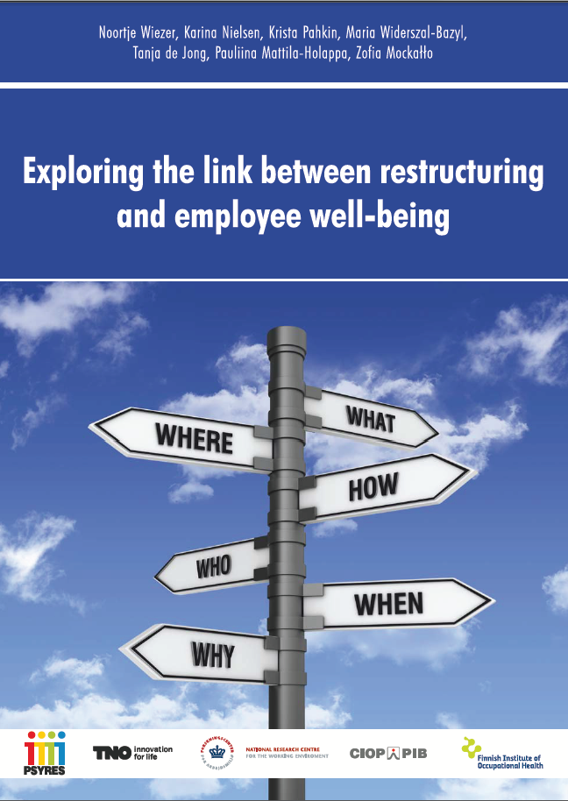
http://www.psyres.pl/CIOPPortalWAR/file/47257/PSYRES_book.pdf

Slide 15
Results from PSYRES
Restructurings often have a negative impact on employee health and well-being
Employees who are exposed to restructuring experience a higher degree of
job insecurity
A lengthy restructuring (min 2 years) have a negative impact on employee health
and well-being. It leads to lower job satisfaction, lower commitment, poorer
general health, increased emotional exhaustion and higher absenteeism
Employees do not get used to restructuring, although they are experiencing
restructuring several times in a row

Slide 16

A good psychological work environment
- When there are changes in the workplace

Slide 17
A good psychological working environment
- When there are changes in the workplace
Stay on top of the changes
Think a good psychological working environment in as an integrated goal of the change
Uncover in advance the opportunities and risks that may be associated with change
Be aware that it can be a challenge to ensure the psychological work environment in their daily work while change is being prepared
Clarify and tell who has what roles and responsibilities associated with the change
Be aware that middle managers, employees and employee groups can have different needs in relation to the change
Make ongoing monitoring and a final evaluation of the change and the change process

Slide 18
A good psychological working environment
- When there are changes in the workplace
Involve the employees
Remember to include the internal working environment organization in matters dealing with the working environment and remember to adjust the risk assessment
Get the employees involved as early as possible in the work with planning, implementing and embedding the change
Make sure that early in the process there is a dialogue on how to work with the psychological working environment.
Make sure to balance the expectations on the involvement of employees in the change process
Use “The annual diskussion” to clarify, what changes will mean

Slide 19
A good psychological working environment
- When there are changes in the workplace
Communicate in the whole of the change process
It is important for management to communicate both the purpose and the need for change - schedule and milestones
Inform as early as possible and in such a way that it provides excellent opportunities for a thorough discussion
Be aware that when management first informs about the proposed change, it will be new for the employees, but well-known to management
Be sure to allocate and prioritize resources and time for ongoing communication and dialogue
Communicate how you expect to deal with the psychological working environment in the period in which you work with change
Focus on managing uncertainty and unrest among employees in connection with the change
Communicate regularly on the process for the creating overview

Slide 20
A good psychological working environment
- When there are changes in the workplace
Support and competences
Have an early dialogue on the need to support actions that can support the psychological working environment. Clarify the need for external assistance.
Clarify whether there is the necessary skills and knowledge in the workplace and in the working environment organization to plan, implement and embed change
Consider what it takes to help employees cope with change
Publish the internal and external support options that are available in connection with the change. Make sure everyone knows who they can turn to for support and coaching

Slide 21
A good psychological working environment
- When there are changes in the workplace
Homepage in connection with the brochure
www.skabgodeforandringer.dk
”www.creategoodchanges
More than 12.000 brochures distributed
More than 141.000 hits on homepage
General feedback:
No other guidance on this
Extremely useful
We use it because it is tripartite

Slide 22
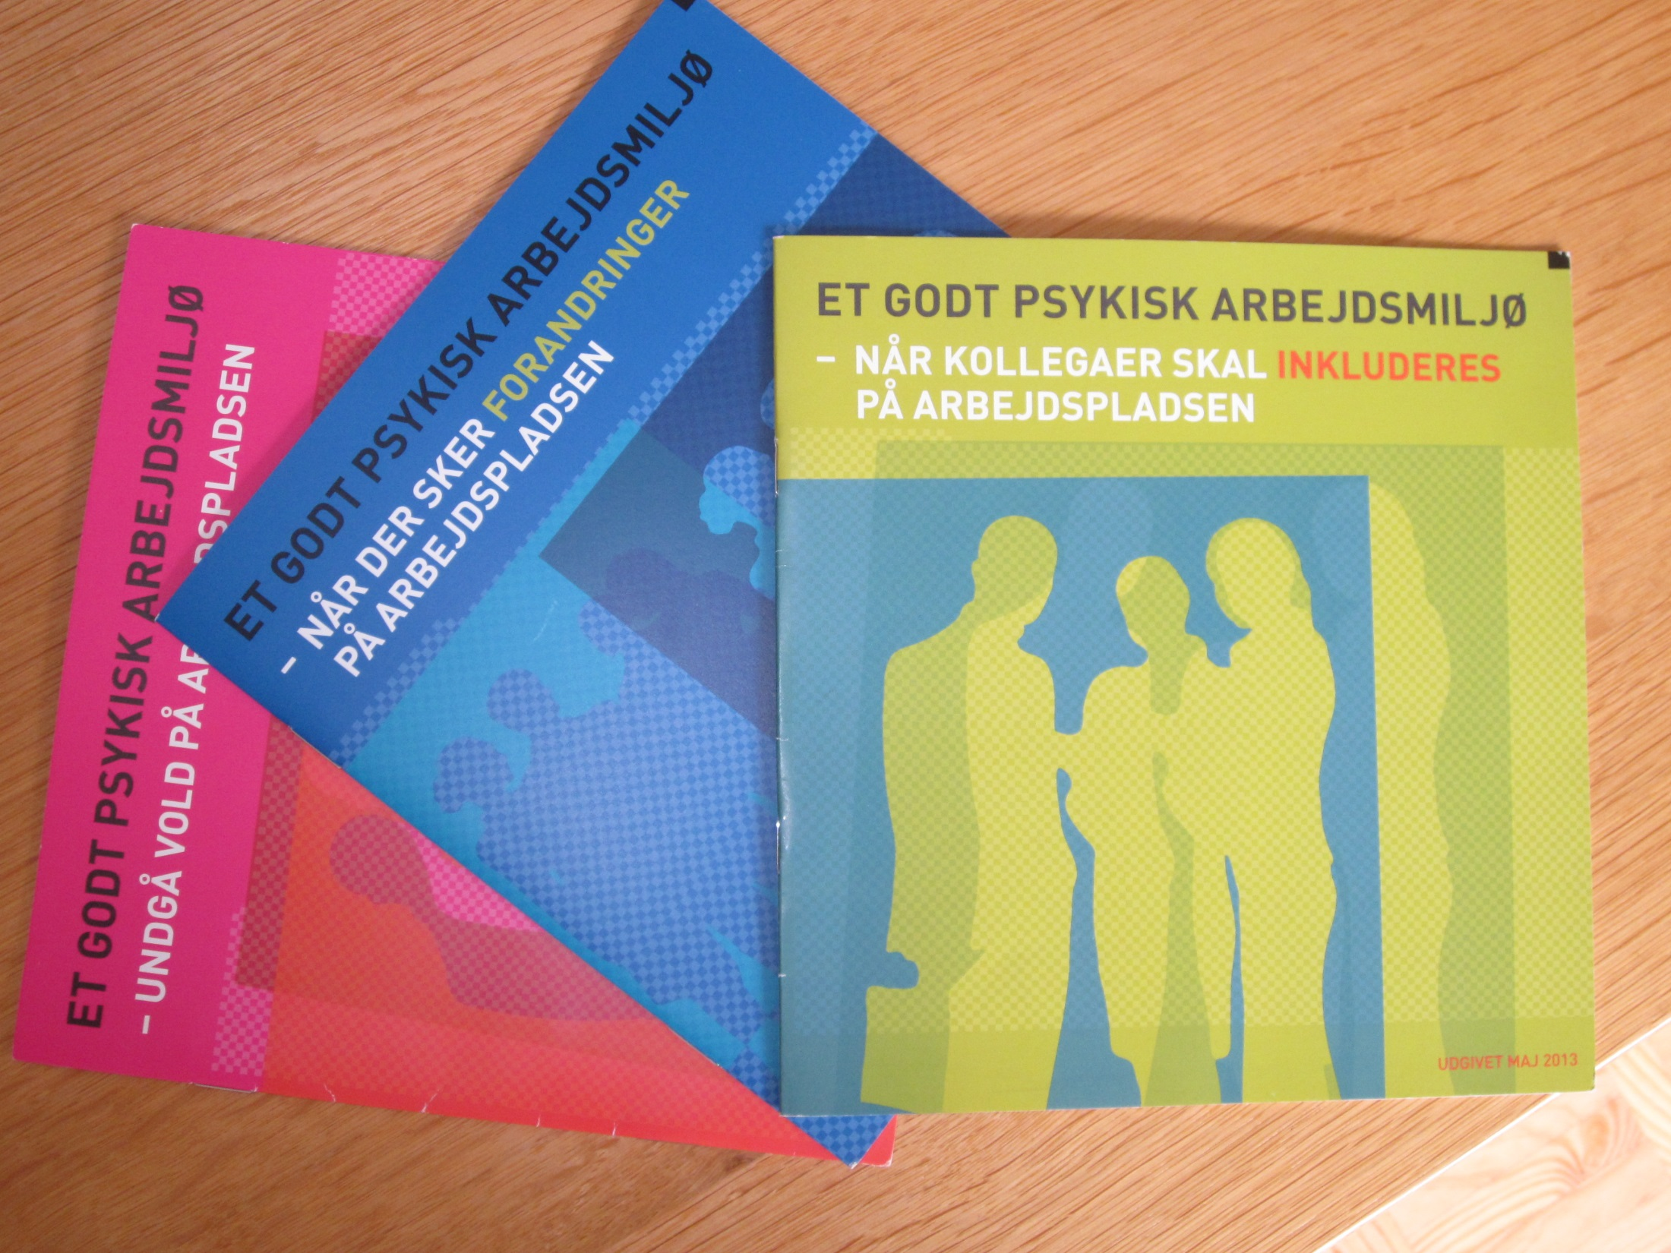

Slide 23
Adressing Psychosocial risk: A tripartie approach
The authority cannot solve problems with psychosocial risks themselves
When employers and workers takes responsability and agree on this issue, change is possible
In the workplace Employee involvement and management commitment is needed
Information and education is strongly needed
It takes time to reduce psychosocial overload
A tripartite approach is highly welcomed by enterprises

Slide 24
Thank You for listening
https://osha.europa.eu/en/publications/reports/healthy-workplaces-good-practice-awards-2014-2015/view

