Slide 1


Nanomaterials in Construction
8th US/EU Joint Conference on Occupational Safety and Health
Ft. Worth, TX
September 18, 2015
Bruce Lippy, Ph.D., CIH, CSP, FAIA
Director of Safety Research, CPWR
blippy@cpwr.com
Notes:
Trainer Notes
Photo of construction worker courtesy of Kiewit Power Constructors.
Thank you

Slide 2
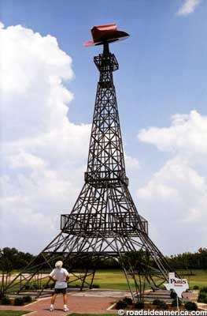
EU Colleagues: Texas isn’t so different from Europe, is it?
Paris, Texas
Roadsideamerica.com
Notes:
From RoadsideAmerica.com: “In a state of towering oil derricks and spidery drill platforms*, passersby do a double-take when they drive by the civic center in the Texas town of Paris. It's not just that dark metal replica Eiffel Tower -- it's the fact that it is adorned with a giant cowboy hat. But then, if you were Paris, Texas, what would you have done?”

Slide 3

CPWR is a U.S. nonprofit funded by NIOSH and NIEHS
http://www.cpwrconstructionsolutions.org
“Promote joint databases on controls”

Slide 4

Buildings consume 40% of energy globally
“Construction materials represent the most easily available medium to distribute photoactive substances over the widest surface area possible.” (Diamanti and Pedeferri, 2013)
Notes:
These figures and quotes are from the text: Nanotechnology in Eco-efficient construction, edited by F. Pacheco-Torgal, M.V. Diamanti, A. Nazari and C-G. Grandqvist, Woodhall Publishing, 2013.
The energy consumption from buidlings in developed countries has reached 40%. (Perez-Lombard et al. 2008) Windows can account for up to 60% of energy loss in a building (Jelle et al., 2012)
“Construction materials represent the most easily available medium to distribute photoactive substances over the widest surface area possible.” (Diamanti and Pedeferri,2013)

Slide 5
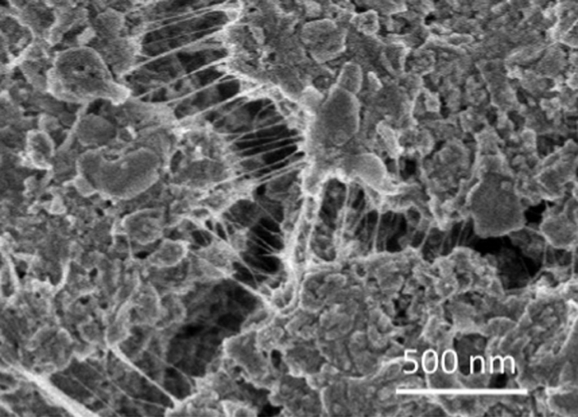
CNTs can reinforce cement at the nano scale with 100X the tensile strength of steel
CNTs bridging a gaps in OPC,
With approval from Hanus and Harris, Progress in Materials Science, 2013
Notes:
From Monica Hanus and Andrew Harris Nanotechnology innovations for the construction
Industry. Progress in Materials Science 58 (2013) 1056–1102.
Quote from the paper: “CNTs have a high tensile strength and Young’s modulus, display elastic behaviour and excellent thermal properties. Indeed, the tensile strength and Young’s modulus of CNTs are hundreds and tens of times that of steel, respectively, although their weight per volume of CNTs is a mere fraction that of steel. CNTs reinforce concrete at the nanoscale rather than the macro scale in the manner of traditional steel reinforcement bars.”

Slide 6

EdenCrete tested CNT concrete road surface on Georgia I-20 August 11, 2015
NIOSH participated
Photo courtesy Wikimedia Commons
Notes:
Perth-based Eden Energy Limited (ASX: EDE) is pleased to announce that the Georgia
Department of Transport has scheduled its first field trial of Eden’s carbon nanotube-strengthened
concrete additive known as EdenCreteTM to take place on Tuesday 11 August 2015, when a small
portion of US Interstate Highway 20 (I-20) that is programmed to undergo re-surfacing as part of a
routine maintenance programme, is to be replaced using concrete enriched with EdenCreteTM.
This field trial will represent a significant milestone for Eden in its quest to have EdenCreteTM
approved in due course for use by the Georgia Department of Transport, and ultimately also by the
Departments of Transport of the other US states, for use on US highway infrastructure programmes
including the repairing and replacing of concrete roads, highways and bridges.
Additionally, the Georgia Department of Transport is also planning in the immediate future to
undertake a range of laboratory tests of concrete enriched with EdenCreteTM.
Subject to a satisfactory outcome of both the laboratory tests and the field trial, Eden is hopeful that
EdenCreteTM will be added in the coming months to the pre-approval list of Georgia Department of
Transport, as an initial step on path towards full approval, which may take up to 12 months or more.
Further, the field trial and the laboratory tests, if successfully completed, are also anticipated to
significantly assist Eden in its plans to raise the necessary funding for the establishment over the next
three-four years of a large scale US production facility for EdenCreteTM, possibly in Georgia, that is
currently intended to be capable of producing sufficient EdenCreteTM to enrichup to 4% of the total
annual concrete requirements of all the US states’ Departments of Transport.
USTRALIAN SECURITIES EXCHANGE ANNOUNCEMENT
10 March 2015
Australian Laboratory Tests of Eden's High Strength Carbon
Enriched Concrete Additive- Update
The first tests in Australia of trial cylinders and beams of concrete, enriched with various proportions of Eden's carbon-enriched concrete additive EdenCrete500 and which were tested 7 days after pouring, have produced encouraging early strength in the concrete.
The best of the 7 day results, achieved with a concrete mix to which the highest proportion of EdenCrete500 had been added (and compared with 7 day old test samples made with the same mix -i.e. the same ratio of cement/ sand/ aggregate- but with no EdenCrete500 added), showed:
• An increase in compressive strength of 21.6%; and • An increase in flexural strength of 61.9%, which is significantly higher than previous results achieved with cement paste. Flexural (or bend) strength (which is similar to tensile strength) is defined as a material's ability to resist deformation under load and is a key requirement for high rise concrete slabs and beams. These Australian laboratory trials are being undertaken by a national concrete company, which is part of a multinational group of concrete and cement companies. Whilst further trails are yet to take place at various times over the next 56 days, these initial 7 day results are considered by Eden to be encouraging. These trials are being undertaken entirely independently of the field trials in Colorado, USA that are currently also underway (see Eden's ASX Announcement of 23 February 2015). EdenCrete500, which in October 2014 won the Australian Civil Contractors Federation's 2014 Environment Award, is designed and formulated to deliver to concrete: • Higher ultimate flexural (tensile) and compressive strengths; • Improved abrasion resistance; • Reduced tendency for corrosion of steel reinforcement; • Improved concrete workability and effectiveness of water-reducer; and

Slide 7
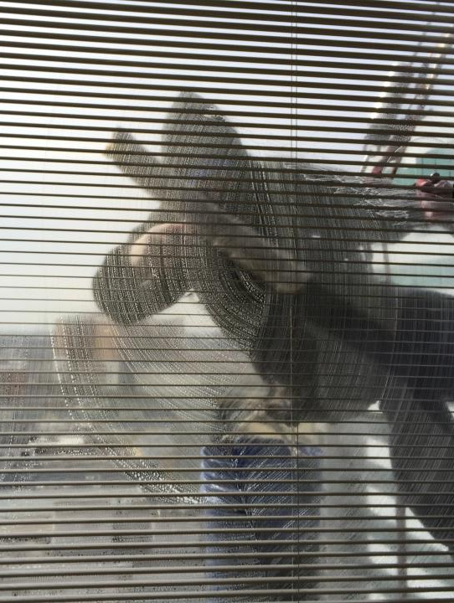
TiO₂ self-cleaning windows can reduce worker fall exposures
March 16, 2015
CPWR’s offices
Notes:
Self-cleaning windows could put people out of work, but would also reduce these kind of exposures.

Slide 8
I will address 3 questions
How do we identify nanomaterials used in construction?
Why worry about construction workers and nano?
What are the findings on assessing and controlling worker exposures to nano in construction?
Notes:
Introduction to CPWR, our nano team and collaborators
Uses of Nano in construction
Inventories (mostly ours)
Uniqueness of construction work
Worker exposures to nano in construction
Areas of possible collaboration
Discussion questions
The vehicle is called a Nano and is built in India

Slide 9
How do we identify nanomaterials used in construction?
1
Question 1
Notes:
Inventories

Slide 10

The Wilson Center’s Project for Emerging Nanotechnology has nearly 2,000 consumer products
Notes:
The Wilson Center’s Project for Emerging Nanotechnology has nearly 2,000 consumer products.

Slide 11
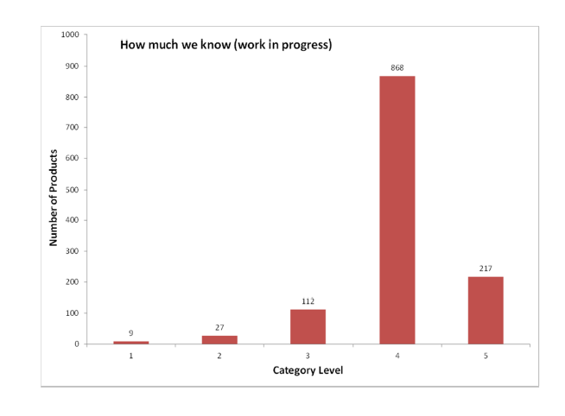
PEN assigns confidence to entries
Unsupported
Not advertised by manufacturer
Manufacturer-supported claim
Extensively verified
verified
From Todd Kuiken’s presentation at NanoSafe2014
Notes:
PEN assigns confidence to entries.

Slide 12

Our site currently contains 487 commercial construction nanomaterials
www.nano.elcosh.org
Notes:
In October 2014 we launched a web-based construction nanomaterial inventory.

Slide 13
Coatings dominate CPWR’s database
Notes:
Coatings dominate the database

Slide 14
Three-quarters have a U.S. address or export to U.S.

Slide 15
178 (38.9%) did not specify the composition
Unspecified composition | 178 | 38.9
nanofibers | 1 | 0.2
nanomaterials | 15 | 3.3
nanoparticles | 76 | 16.6
nanotechnology | 70 | 15.3
nanotubes | 1 | 0.2
photocatalytic materials | 5 | 1.1
reference to 'nano' | 10 | 2.2
Nanotechnology 70 15.3
Safety Data Sheets could not be confirmed for 55% of products
Notes:
178 (38.9%) did not specify the composition.

Slide 16
Why worry about construction workers and nano?
1
2
Question 2
Notes:
Uniqueness of construction work

Slide 17
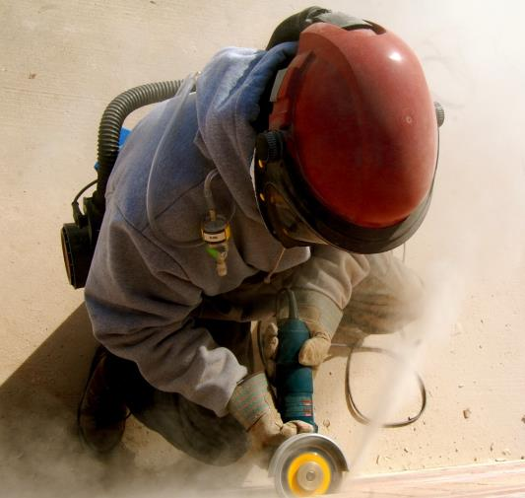
Construction workers apply greater energy to nanomaterials
Notes:
Bystander exposures are much more prominent in construction.

Slide 18



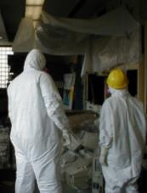
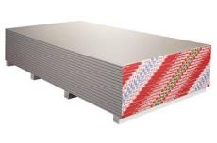

Construction exposures may be greater when the life cycle is considered
Recycling/
Demolition/
Production
Installation
Maintenance
What happens with Hazcom?
Notes:
Exposures must be considered over the life cycle of products. What happens with Hazcom?

Slide 19
“80% of the workers’ reps and 71% of the employers’ reps were not aware of the availability of nanomaterials and were ignorant as to whether they actually use nanomaterials at their workplace.”
2009 Survey of workers and employers in 14 countries in Europe
Broekhuizen et al. 2011
Notes:
“80% of the workers’ reps and 71% of the employers’ representatives were not aware of the availability of nanomaterials and were ignorant as to whether they actually use nanomaterials at their workplace.”Part of the inventory was a questionnaire set out by the FIEC and the EFBWW among their members in 24 European countries (hereafter called the 2009-survey). A strategic selection of 144 well-informed FIEC and EFBWW contact persons in the Member States resulted in 28 completed questionnaires from 14 European countries. Completeness was not pursued, as this would require a much more elaborate approach. by in-depth interviewing of construction employers and workers, architects, raw material, and product manufacturers as well as R&D scientists, in total ca 45 interviewees from Western European countries and 5 from the USA and Canada.

Slide 20
CPWR surveyed 79 worker-trainers from 22 trades with an average of 30 years in the trade (2013-2014)
Survey Respondent Characteristics | N | Mean | SD | Range
Years in trade | 78 | 30.5 | 9.4 | 9-55
Years as a trainer | 79 | 13.3 | 7.8 | 1-34
Notes:
Just over half of respondents were aware that nanotechnology has been applied to construction materials, but most did not know that construction products containing nanomaterials are commercially available in the USA. Only 15% of respondents reported seeing a construction nano-product in person. Of the 10 people (13%) who were aware of a nano-enabled product used on a job site, only 5 provided further detail. Three people specified aerogel insulation, one person wrote "plastering and concrete", and one person indicated that he or she could not recall the details. The remaining five people who answered yes to question 7, did not respond to the second part of the question. The vast majority of participants, almost 90%, had not addressed nanotechnology during training. Just over half of respondents were aware that nanotechnology has been applied to construction materials, but most did not know that construction products containing nanomaterials are commercially available in the USA. The vast majority of respondents reported not having seen a nanomaterial on their jobsite.

Slide 21
Nearly half were not aware that nano had been applied to construction materials
 | Yes | No
Aware that nanotechnology has been applied to construction materials? | 41 (52%) | 38 (48%)
Aware that construction products containing nanomaterials are commercially available in the USA? | 38 (48%) | 41 (52%)

Slide 22
Only 3 out of 79 had heard of NIOSH’s Nano RELs
Nanomaterial | OEL (mg/m³) | Year
Titanium dioxide | 0.3 ultrafine 2.4 fine | 2011
CNTs and nanofibers | 0.001 | 2013
Notes:
NIOSH’s RELs are having a major impact in the absence of PELs.

Slide 23
What are the findings on assessing and controlling worker exposures to nano in construction?
1
2
3
Question 3
Notes:
Uniqueness of construction work

Slide 24
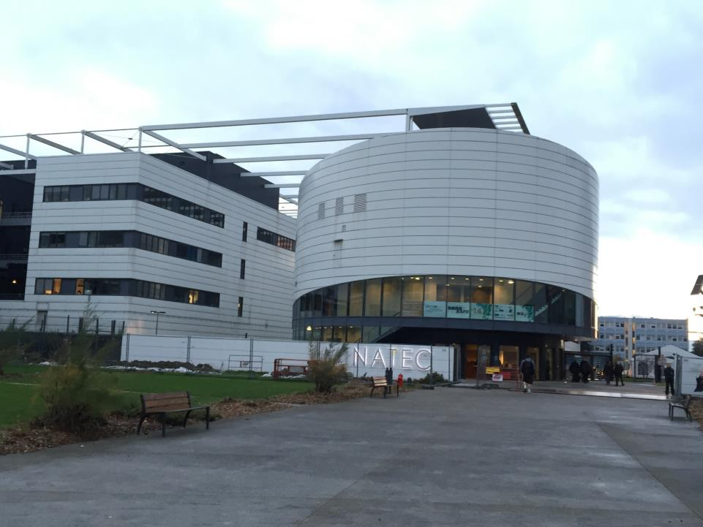
Europeans have been leading on nano release research
NanoSafe2014 at Minatec in Grenoble, France
Notes:
The Europeans are doing important work on nanorelease.
I attended this conference and would like to present some of the key findings that relate to measuring exposures to construction workers.

Slide 25


Vaquera et al. conducted worker exposure monitoring for TiO2 during full lifecycle
Graphic from Vaquera et al. Nanosafe 2014 presentation
Notes:
Vaquera et al. conducted worker exposure monitoring for TiO2 during full lifecycle.
This graphic is from Vaquera and colleagues’ Nanosafe 2014 presentation

Slide 26
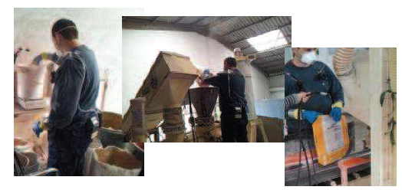
Sampled during manufacturing of 1 ton of each of 3 types of mortar
Photos from Vaquera et al. Nanosafe 2014 presentation
Notes:
Sampled during manufacturing of 1 ton of each of 3 types of mortar.
This was not a minor sampling effort.
Photos from Vaquera et al. Nanosafe 2014 presentation

Slide 27
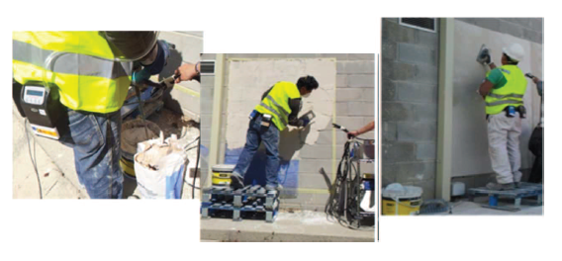
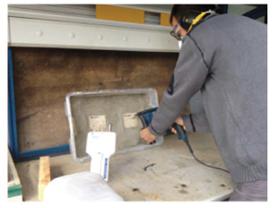
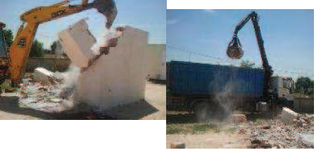
Sampled during application, drilling and demo
Photos from Vaquera Nanosafe 2014
Notes:
The researchers sampled during application, drilling and demo.
Photos from Vaquera et al. Nanosafe 2014 presentation

Slide 28
Vaquera and colleagues concluded:
TiO2 exposures were well below the OELs for all scenarios (0.1 mg/m3 Scaffold, 0.3 mg/m3 NIOSH)
Highest mass concentrations
  Cleaning during manufacturing
  Sol-gel spraying of depollutant on wall
Notes:
Vaquera and colleagues concluded:
TiO2 exposures were well below the OELs for all scenarios (0.1 mg/m3 is the level through the Scaffold project and 0.3 mg/m3 NIOSH)
Highest mass concentrations
Cleaning during manufacturing
Sol-gel spraying of depollutant on wall

Slide 29
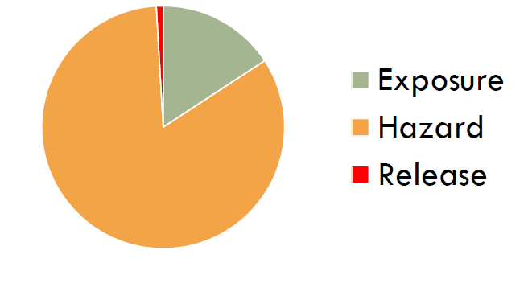
Froggett et al. presented a review of 54 studies on release of nanomaterials from solid nanocomposites
Froggett S, Clancy S, Boverhof D and Canady R (2014) Particle and Fiber Toxicology
Graphic from Froggett presentation NanoSafe 2014
Notes:
Froggett et al. presented a review of 54 studies on release of nanomaterials from solid nanocomposites.
Froggett S, Clancy S, Boverhof D and Canady R (2014) Particle and Fiber Toxicology
Graphic from Froggett presentation NanoSafe 2014

Slide 30
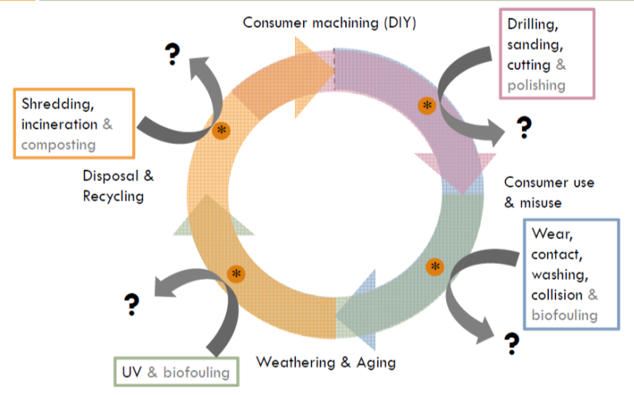
The studies followed the full life cycle of nanocomposites
6
24
14
17
Froggett et al. (2014) Particle and Fiber Toxicology, Graphic from Froggett presentation NanoSafe 2014
Notes:
The studies followed the full life cycle of nanocomposites. The numbers represent the quantity of studies in each part of the life cycle.
Froggett S, Clancy S, Boverhof D and Canady R (2014) Particle and Fiber Toxicology
Graphic from Froggett presentation NanoSafe 2014

Slide 31
Froggett et al. found:
Release of fine and ultrafine matrix debris from both composites and nanocomposites is common under all release scenarios
Some of the debris contained the added nanomaterials either partially or fully embedded
Release of the added nanomaterials fully dissociated from the matrix has been detected only occasionally
Froggett S, Clancy S, Boverhof D and Canady R (2014) Particle and Fiber Toxicology
Notes:
Froggett et al. found:
Release of fine and ultrafine matrix debris from both composites and nanocomposites is common under all release scenarios
Some of the debris contained the added nanomaterials either partially or fully embedded
Release of the added nanomaterials fully dissociated from the matrix has been detected only occasionally

Slide 32
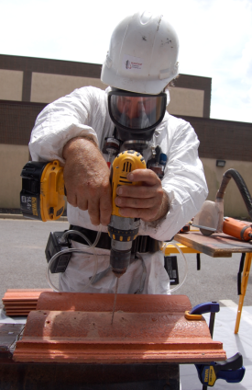

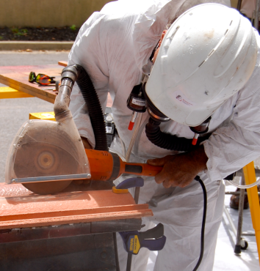
CPWR and EPI conducted a range of sampling during the cutting, drilling and nailing of tiles
Notes:
CPWR and EPI conducted a range of sampling during the cutting, drilling and nailing of tiles.

Slide 33

We tested these smog eating tiles that contain TiO₂

Slide 34

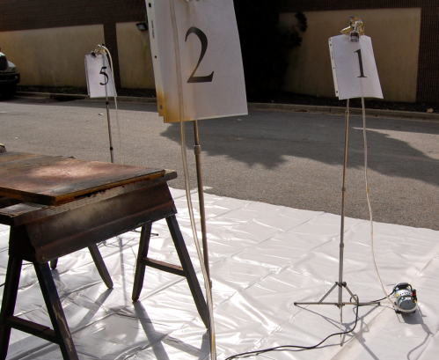
We collected respirable dust, TiO₂ metals and TEM as well as CPC and OPC particle counts
Notes:
We collected respirable dust, TiO₂ and TEM as well as CPC and OPC particle counts.

Slide 35



We conducted sampling during tile grinding with LEV on and off
RIDGID 15-Amp 7 in. Angle Grinder
Cut Buddy
Ermator S26 HEPA Dust Extractor
Notes:
We conducted sampling during tile grinding with LEV on and off. This first test session allowed us to grind off the surface containing the TiO2 for a worst case exposure.

Slide 36
We followed NIOSH Methods
Agent | Method | Media
Total Dust | 0500 | 37-mm cassette with 5-micron pre-weighed, PVC filters
Titanium dioxide | 7300 | 37-mm cassette with 5-micron pre-weighed, PVC filters
Titanium dioxide | 7402 modified TEM | 25mm open-face cassettes with 0.45-micron MCE filters
Lesson learned: NIOSH validated methods work for nano
Notes:
We followed NIOSH Methods.

Slide 37
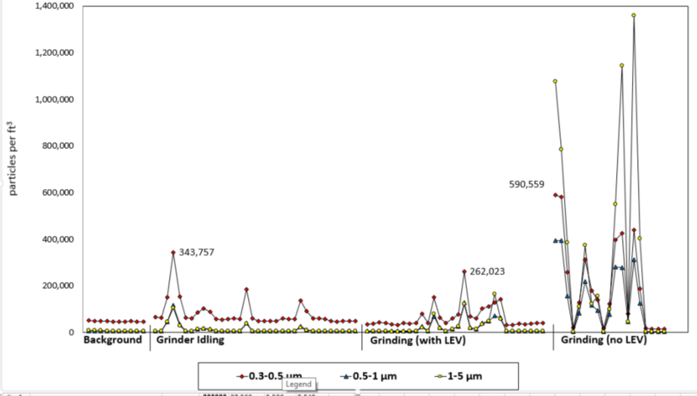
Ventilation greatly reduces exposure
Particle counts with TSI 9306 optical particle counter

Slide 38
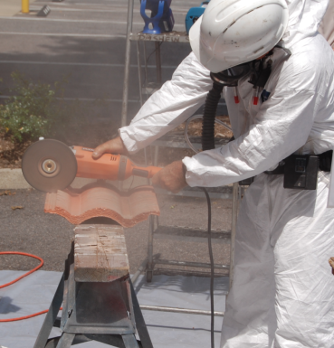
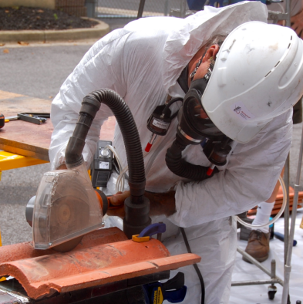
Most results were encouraging
All measurements were below the NIOSH REL for ultrafine TiO₂ of 0.3 mg/m³
Ventilation on the tool reduced respirable dust by roughly 50% (88 – 97% in chamber)
Notes:
Most results were encouraging.
All measurements were below the NIOSH REL for ultrafine TiO₂ of 0.3 mg/m³
Ventilation on the tool reduced respirable dust by roughly 50%

Slide 39
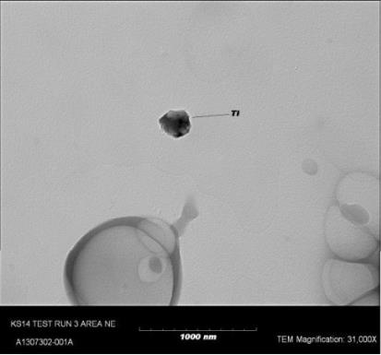
There were unagglomerated TiO₂ particles, however
41% of structures counted via TEM were free and not agglomerated
Notes:
There were unagglomerated TiO₂ particles, however.
41% of structures counted via TEM were free and not agglomerated.

Slide 40

Think about the AIHA Nanotechnology Working Group as a resource for your work

Slide 41

Thanks! Questions?
Bruce Lippy, Ph.D., CIH, CSP
Director of Safety Research blippy@cpwr.com
301-495-8527
410-916-0359 cell http://www.elcosh.org
Notes:
Trainer Notes:
Try us out! Go to our site: http://www.elcosh.org or contact our Project Manager, Bruce Lippy:
Office: 301-495-8527
Cell: 410-916-0359

