Slide 1
Deborah A.P. Hersman
President & CEO
National Safety Council
Notes:
Thank you. Good morning and thank you for having me here today.
The mission of the National Safety Council is to prevent injuries and deaths on our roads, in our homes and communities, and of course at work. We do this through leadership, research, education and advocacy.
It was a century ago when industry leaders got together with the fervent belief that injuries and deaths in our workplaces didn’t have to be “the cost of doing business.” They believed that productivity and safety could -- and should – coexist. They believed that keeping workers safe was not only possible -- but the right thing to do.
Preventing injuries and saving lives since 1913
Partnering with businesses, government agencies, elected officials and the public
15+ years serving more than 100 countries
51,000 member companies reaching 8.5 million employees

Slide 2
5. Don’t assume
Do not make assumptions when investigating incidents.
Ask “Why?” at least five times to get to the root cause.

Slide 3
Gray Summit, MO. Aug 5, 2010
Notes:
There’s always more to the story
Chain of events

Slide 4
4. Get sleep
30% of the population has a sleep disorder.
Fatigue is more than falling asleep – it is how you perform when you are tired.
Notes:
The fact is every one of us needs sleep. It is foundational to good health and your quality of life. I guarantee that you'll make better decisions and have better relationships if you are well-rested.
We all need about 8 hours a night.
30% of the population has a sleep disorder.
Studies show that over time, people who get six hours of sleep, instead of seven or eight, begin to feel that they’ve gotten used to less sleep. But if you look at how they actually do on tests of mental alertness and performance, they continue to go downhill. There’s a point in sleep deprivation when we lose touch with how impaired we are.
Fatigue is more than falling asleep, it is how you perform when you are fatigued – your interactions with others, decision making, judgement.

Slide 5
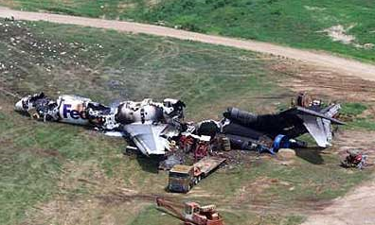
Tallahassee, FL, 2002
Notes:
Coming to work prepared – physically and mentally
How many of your employees report to work fatigued?
There is no blood alcohol test for fatigue
During investigations, do you think about fatigue? What the person was doing in the past 24 hours? Takes effort to investigate but you do get a fuller picture.

Slide 6
3. Double and triple check
Employee engagement is key – everyone needs to be on the lookout for hazards.
Even small errors can have big consequences.

Slide 7
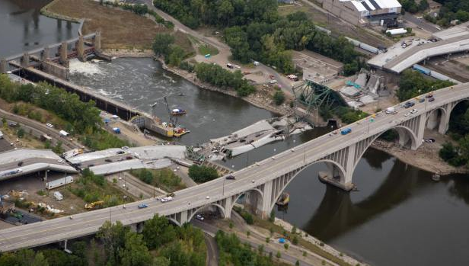
I -35 Bridge Collapse, Aug 1, 2007

Slide 8
2. Change is constant
Stay informed and be aware of trends.
Be on the lookout for new safety challenges.
Notes:
What does Darwin say….
Survival of the fittest

Slide 9
Rise of the Opioid Epidemic
Notes:
Who would have thought even 10 years ago that overdoses from prescription painkillers, such as Vicodin and Oxycontin, would become the epidemic that it is today.
Opioids account for 46 deaths each day in the United States -- more than any other drug.
The rise of opiod misuse in the States is just one example of a changing safety landscape. Who knew what Nanotechnology was 5 years ago?
Uber didn’t even exist.

Slide 10
1. And never forget… People matter
Notes:
Each of you as a leader matter– it is about what you promote and what you permit
Each person is essential to building the right culture – believing in the right people

Slide 11
