Slide 1
Tackling Psychosocial Risks: lessons learned from campaigning and ESENER-2
Dr Christa Sedlatschek
Director
Fort Worth Texas: 18 September 2015
8th Joint US-EU Conference on Occupational Safety and Health

Slide 2
ESENER-2
Topic - How establishments manage safety and health risks at their workplace –focus on psychosocial risks.
  36 countries: EU-28 + Albania, Iceland, Macedonia, Montenegro Norway, Serbia, Switzerland and Turkey.
  49,320 interviews
  47 national versions of questionnaire -adapted for language and national OSH terminology
Smallest business size: 5 workers
Sector coverage: all, including public and agriculture and fishing (except private households and extraterritorial organisations)
One questionnaire per establishment (~25 min)
Respondent: ‘person who knows most about safety and health at the workplace’
Fieldwork: 14 July -20 October 2014.
  First findings report:
    https://osha.europa.eu/en/publications/reports/esener-ii-first-findings.pdf

Slide 3
ESENER-2 – Risk factors present in the establishment (% establishments, EU-28)
Base: all establishments in the EU-28.
Note: psychosocial risk factors shaded in green.

Slide 4
ESENER-2 - Difficulties in addressing psychosocial risks, by establishment size (% establishments, EU-28)
Base: establishments in the EU-28 that report at least one psychosocial risk factor to be present in their establishments.

Slide 5
Management of stress and psychosocial risks
ESENER survey: 79% of European managers concerned about stress at work
- less than 30% establishments have procedures in place to deal with
stress, workplace violence and harassment
- 42% managers consider it more difficult to manage psychosocial risks
than more ‘traditional’ OSH risks

Slide 6
ESENER-2 – Lacking information or adequate preventive tools (% establishments, EU-28)
Base: establishments in the EU-28 that report the particular risk to be present. What do they need to tackle stress and other risks.
Note: psychosocial risk factors shaded in green.

Slide 7

Healthy Workplaces Manage Stress - key objectives
Raising awareness about the growing problem with stress and psychosocial risks
Focus on the positive effects of successful psychosocial risk management, including the business case
Increasing the enterprises’ practical knowledge related to recognising and preventing psychosocial risks at work
Providing and promoting the use of simple, practical tools and guidance for managing psychosocial risks and stress in the workplace

Slide 8
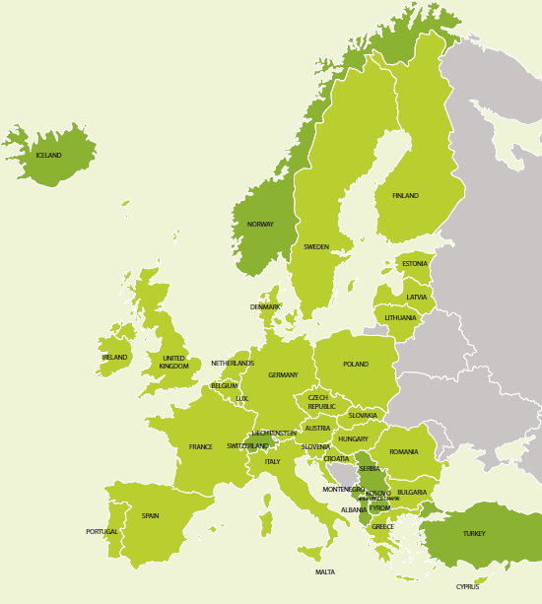
Key strength:
Network of partners
Healthy Workplaces Campaign 2014-15
National focal points
Social partners
Official campaign partners
Media partners
EU institutions and networks

Slide 9
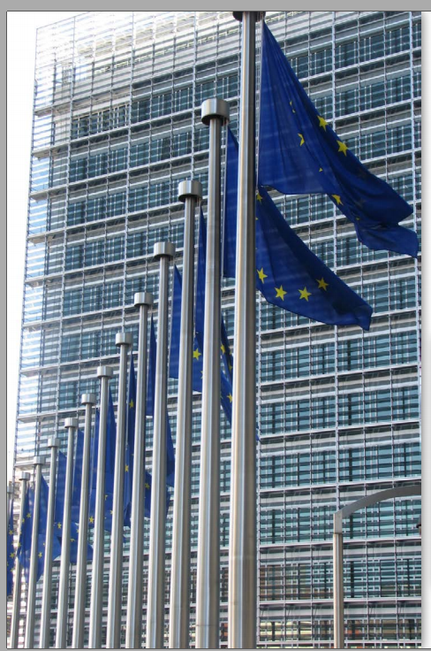
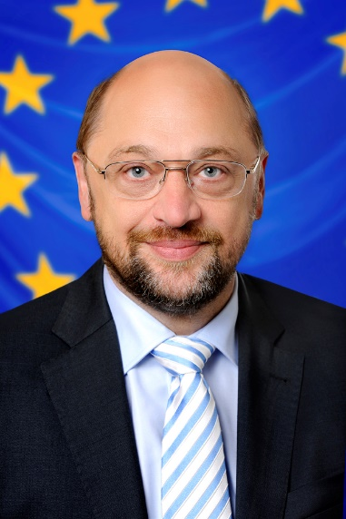
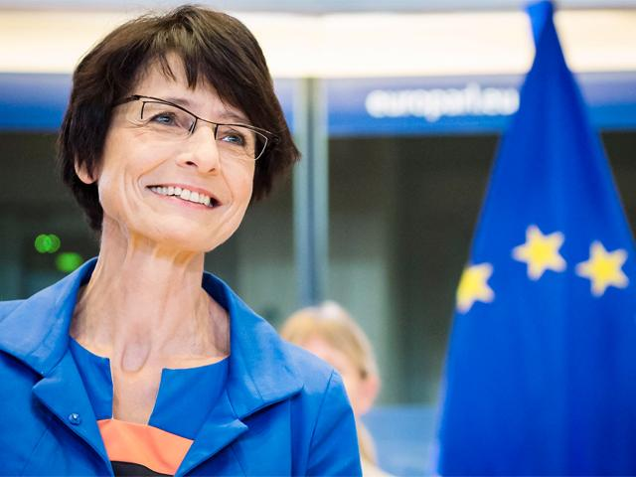
EU Institutions
European Commission
European Parliament
EU Council Presidencies: Latvia, Luxembourg, Netherlands, Slovakia

Slide 10
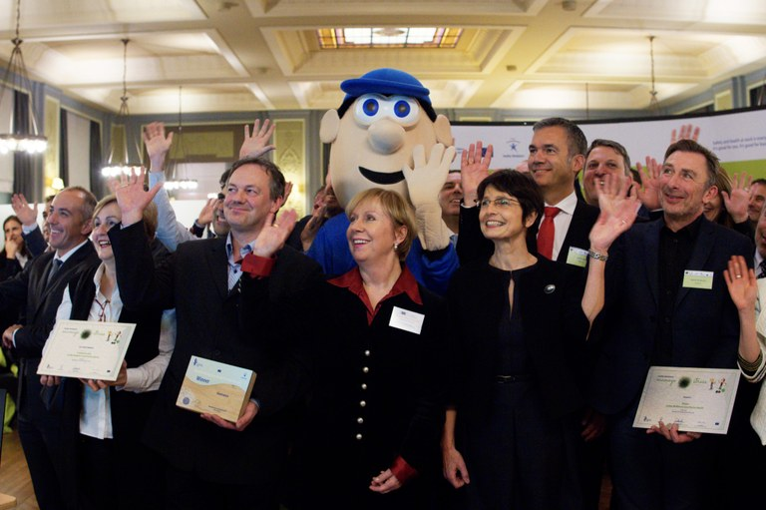
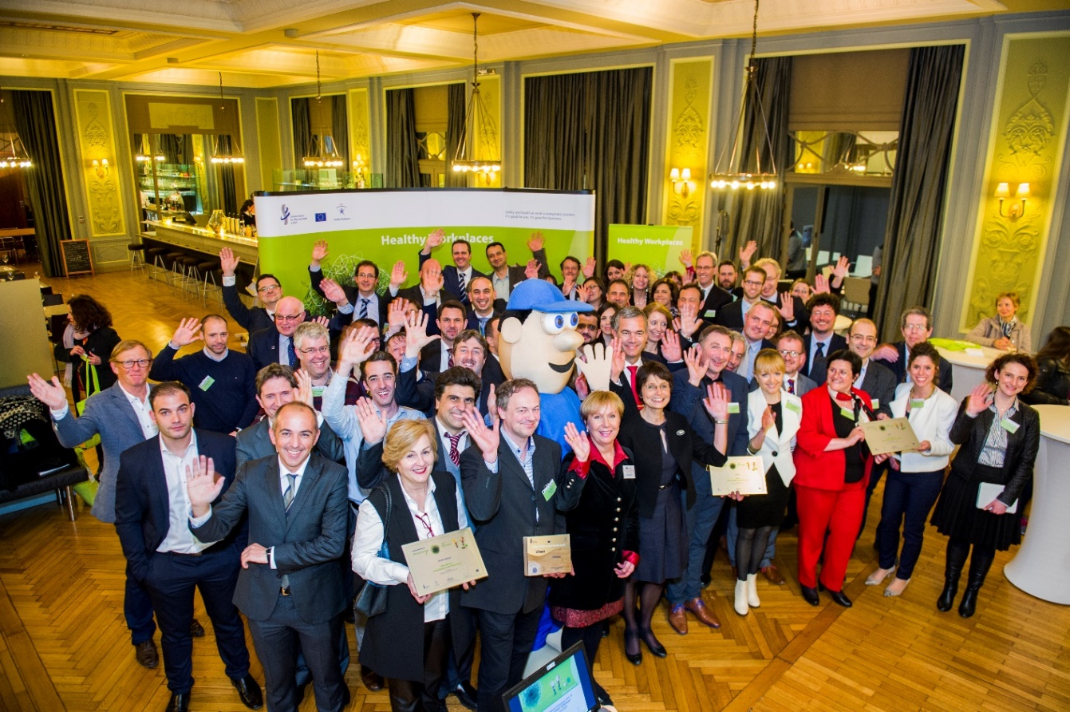
Official Campaign Partners 2014-15
Over 100 Official Campaign Partners
Win-win deal

Slide 11
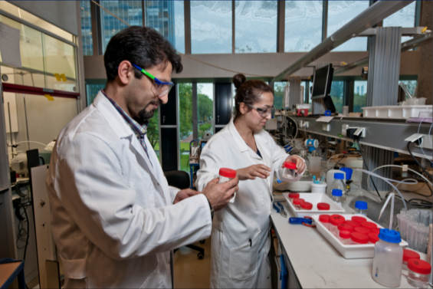
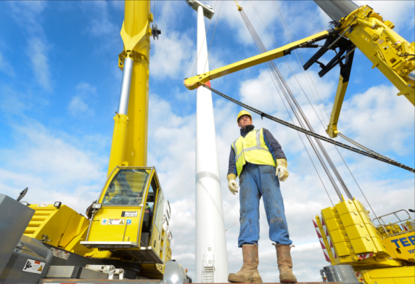
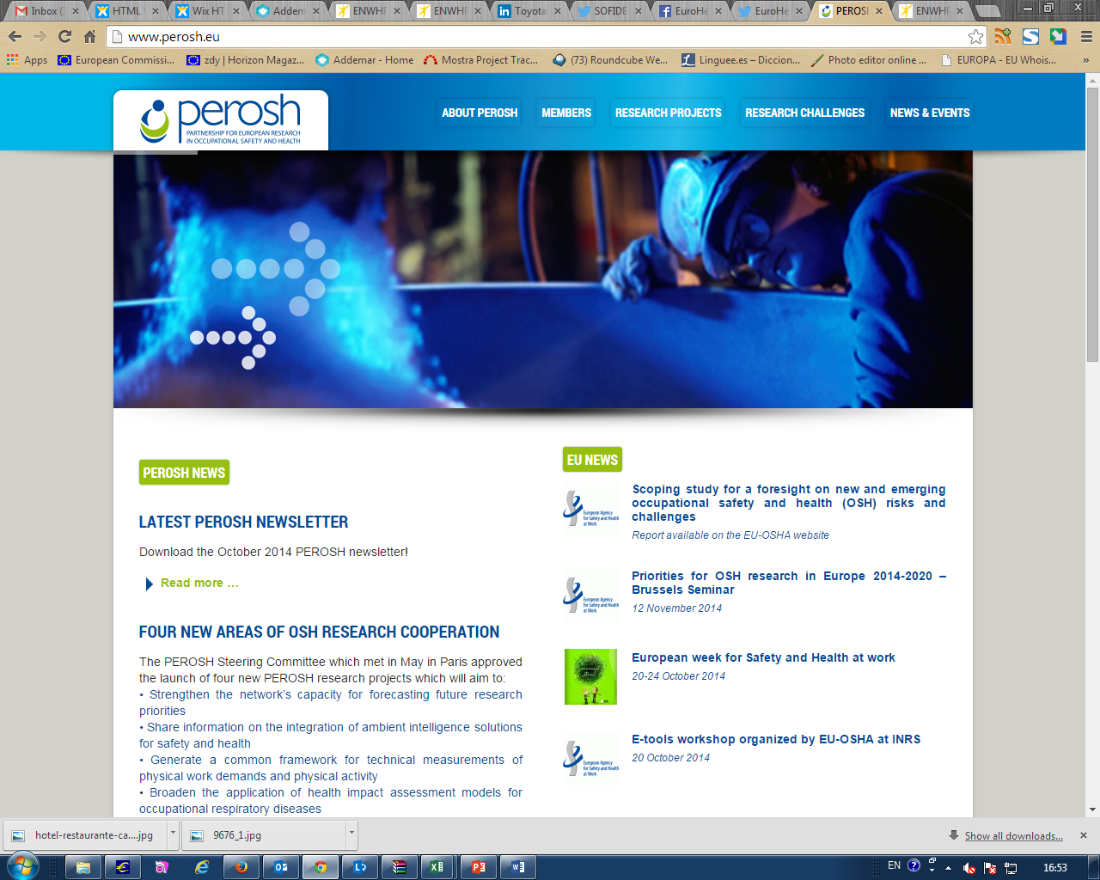
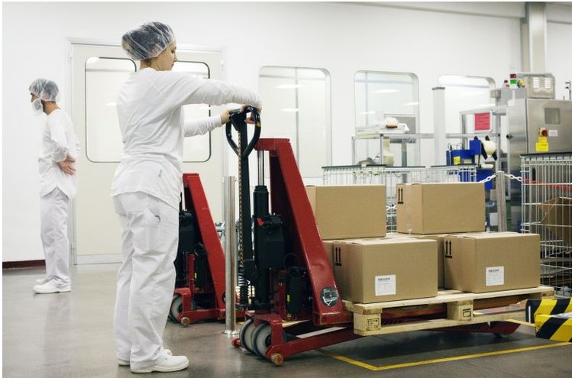
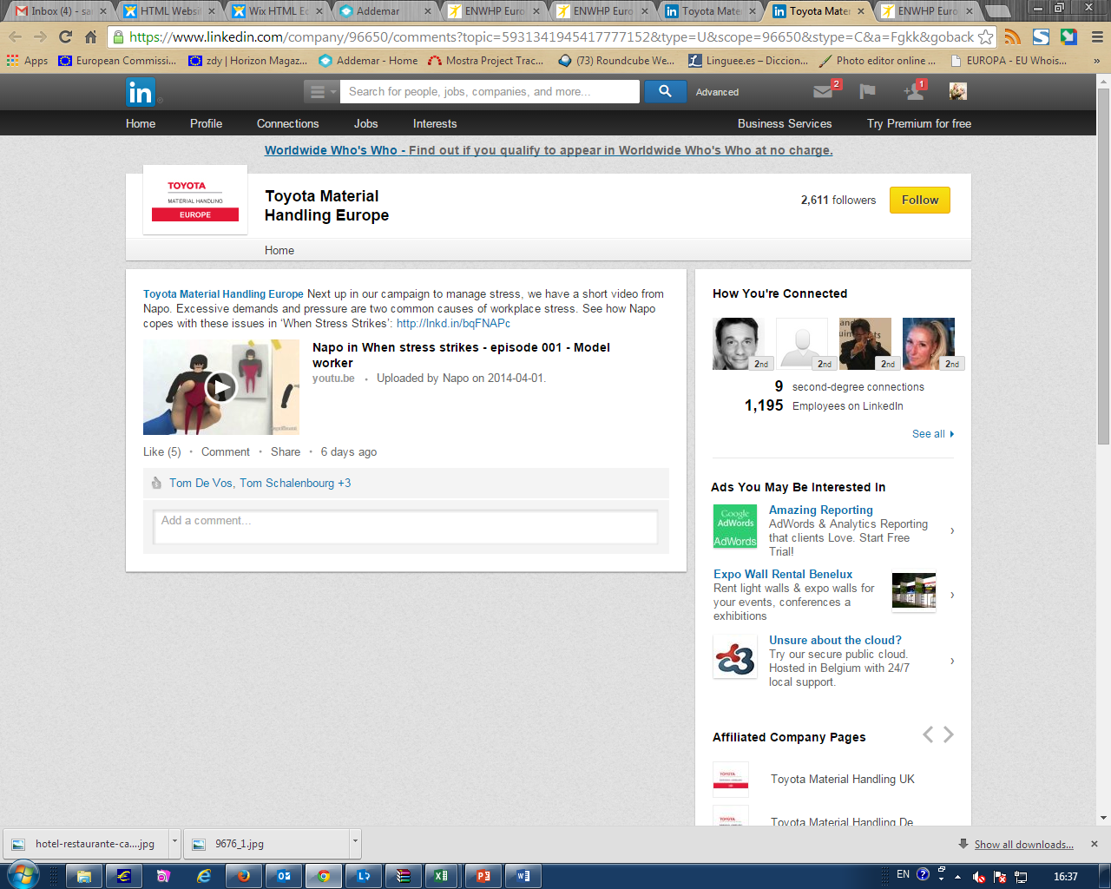
Campaign Partner activities
  Training and coaching
  Workshops and seminars
  Conferences
  Benchmarking activities
  Online activities (incl. social media)
Notes:
Examples:
Airbus France : "On ne badine pas avec le stress« - December 2014
This event was organised for those who perform a detection role in the prevention network at Airbus France. After a discussion about their role, they attended a play titled, 'On ne badine pas avec le stress' performed by Theatre à la Carte. This was followed by an open exchange between participants and the actors.
Association of European Public Postal Operators (PostEurope) – 2014-15
The partnership involves 8 organisations: La Poste, PostEurop, Deutsche Post DHL, Hellenic Post, KEK-ELTA, Swiss Post, InoSalus and bpost. The objective is to share best practices in order to identify and manage stress for the middle management.
EuroHealthNet roundtable on mental health promotion at work – May 2015
The purpose of the roundtable was to bring together members, partners and external mental health experts to take stock of the lessons learned from initiatives such as the Joint Action on Mental Health Wellbeing and EU-OSHA’S Healthy Workplaces Manage Stress campaign
For more info see https://www.healthy-workplaces.eu/en/campaign-partners/official-campaign-partners/eurohealthnet/eurohealthnet-roundtable-on-mental-health-promotion-at-work-final-report-is-now-online.
European Federation of Public Service Unions (EPSU) and the European Hospital & Healthcare Employers’ Association (HOSPEEM): 2014-15
Joint project to promote “Psychosocial risks and stress at work” and “musculoskeletal disorders”. Conference on 10 November 2015 focusing on the role social partners can play in preventing and reducing these stress and psychosocial risks, along with introducing good practices.
See for more http://www.epsu.org/a/10896

Slide 12





Benchmarking initiative
Initiative from Campaign Partners
Added value for campaign partners
      Exchange of good practices
      Better OSH management
Added value for EU-OSHA
    Strong link to campaign & reinforcing its messages
    Support to Official Campaign Partners
    Improvement of OSH at workplace level
On-site workshops
Notes:
SIEMENS, Benchmarking seminar (Berlin, 14-15 October 2015)
SEAT, ‘SEAT Health and Safety Days’ (Barcelona, 30 June -1 July 2015)
TOYOTA, ‘Indicators of OSH Performance’ (Sweden, 26-27 November 2014)
LEGO, ‘Learning from incidents and accidents’ (Denmark, 23-24 September 2014)
HEINEKEN, ‘Leadership training and OSH competence of all responsible actors’ (The Netherlands, 2 July 2014).

Slide 13

Media partners
European journalists and editors
Interested in occupational safety and health (OSH)
Linked to Healthy Workplaces Campaign
Currently 34 media partners from 15 countries
  Mainly OSH magazines
  Human resources, business, trade
  Print, online, blogs, TV
More than 500 clippings in 2014
Notes:
Exclusive pool of journalists and editors from all over Europe interested in occupational safety and health (OSH)
Linked to HWC
Examples:
Q&A live Twitter chat with PPE.org : www.healthy-workplaces.eu/en/news/eumanagestress-2013-let2019s-tweet-about-it
‘Safety culture from school’ project by Aragon Valley at www.healthy-workplaces.eu/en/campaign-partners/media-partners/aragon-valley/project-201csafety-culture-from-school201d-closing-the-loop
Safety Management: expert round-tables, stress safety guide,
publications distributed at British Safety Council events

Slide 14

Campaign activities at national level
National focal points and their networks (activities organised with direct EU-OSHA support):
  39 national partnership meetings
  139 stakeholder seminars
  Over 11 000 active participants
  10 journalist and experts round tables
  17 press conferences
  37 press releases
  And many more !!!!!

Slide 15
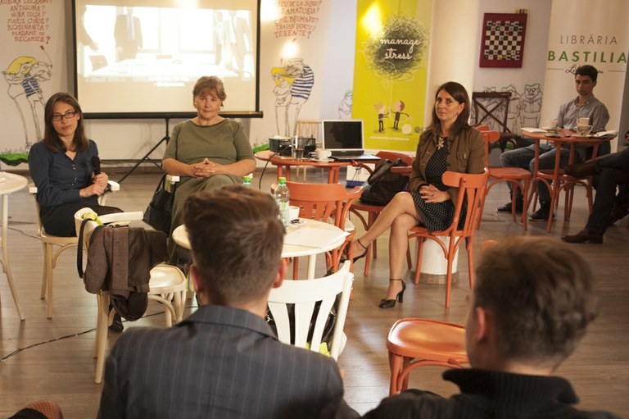

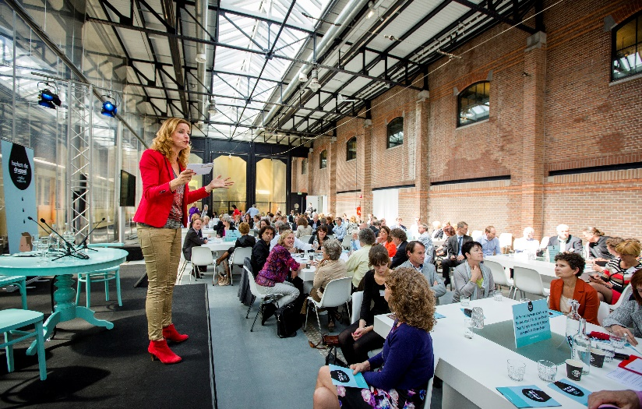
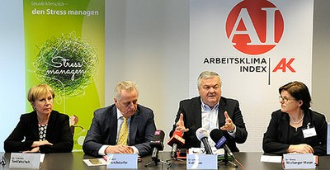
National Focal Points activities
FOP activities: conferences, exhibitions, debates
Notes:
Photo 1 - Romania: Film screening & debate (July 2015)
Winner of the 2012 Healthy Workplaces Film Awards: ‘Work hard, Play Hard’
Discussion with students afterwards
Photo 2 - Spain: Theatre play ‘Tip of the iceberg’ (October 2014)
Followed by a debate on stress and psychosocial risks at work.
Photo 3 - The Netherlands: Congress launching ‘Check your work-related stress week’ (November 2014)
For more info see https://www.healthy-workplaces.eu/en/news/the-last-drop-before-the-bucket-floods-2013-the-netherlands-checks-its-work-related-stress
Photo 3 - Austria: international expert seminar (March 2015)
Co-organised by the federal Austrian Chamber of Labour together with its regional partner AK, in Upper Austria. It was an opportunity to present research results from various organisations that have recently carried out their own studies into occupational safety and health, specifically around psychosocial risks and occupational stress.
For more info see https://www.healthy-workplaces.eu/en/news/insights-into-psychosocial-risks-presented-at-international-expert2019s-conference-in-Vienna

Slide 16
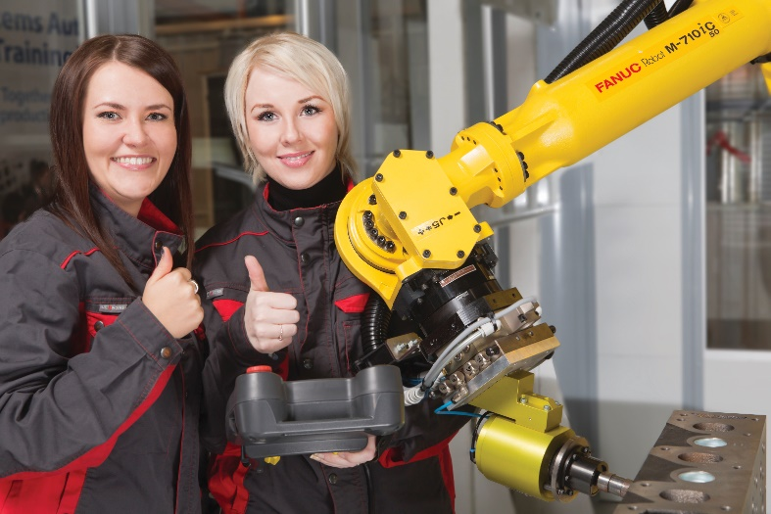
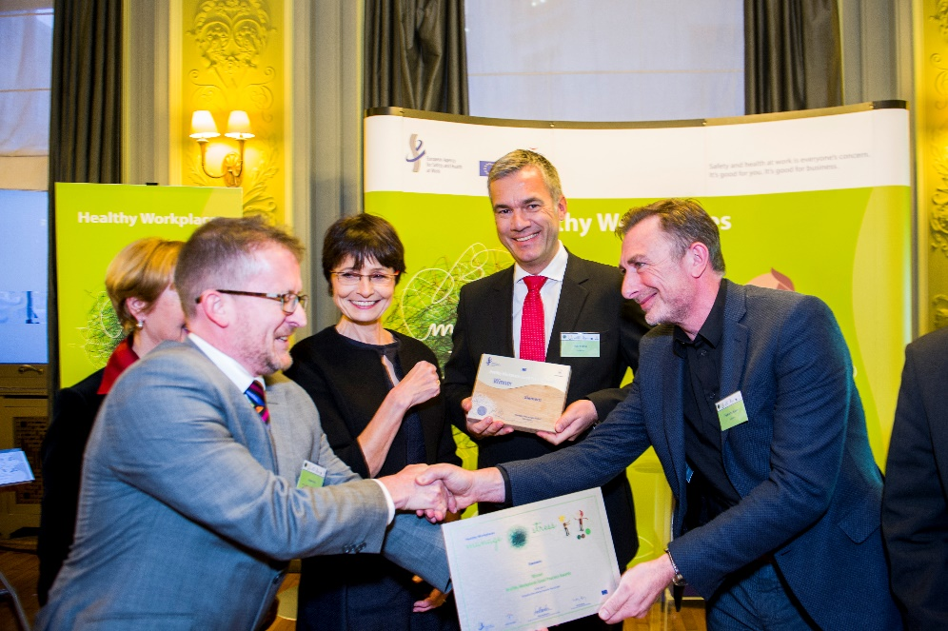
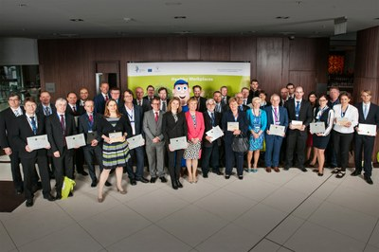
Healthy Workplaces Good Practice Awards 2014-15
Hundreds of entries submitted at national level
11 awarded and 9 commended entries
Award Ceremony
  In cooperation with the Latvian EU Presidency
  Riga: 27-28 April 2015

Slide 17
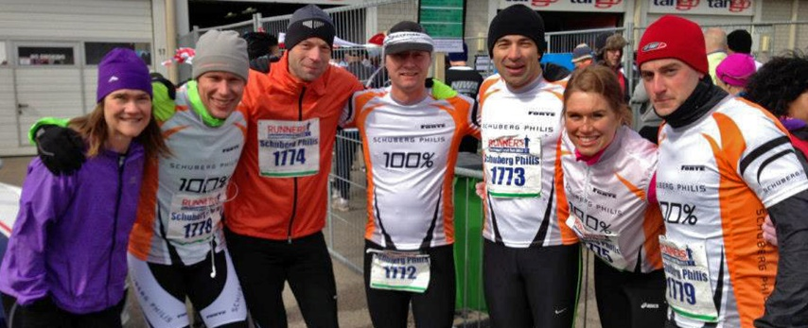
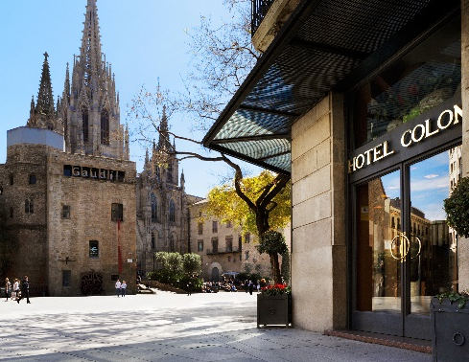


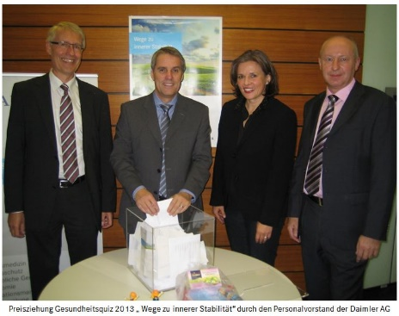
Award Winners
Denmark: Lan & Spar Bank
Finland: Fastems Oy Ab
Germany: Daimler AG and Deutsche Post DHL Group
Netherlands: Schuberg Philis
Poland: Regional Inspectorate of Prison Service in Koszalin
Slovakia: U.S. Steel Kosice, s.r.o.
Slovenia: Zavarovalnica Triglav d.d.
Spain: Hotel Colón S.A.
United Kingdom: Nottingham City Homes
Campaign partner category: Siemens

Slide 18

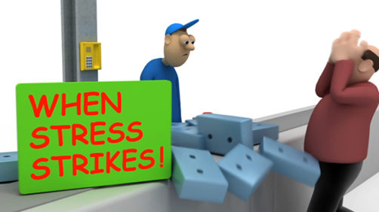
Campaign resources
Multilingual Campaign Website (www.healthy-workplaces.eu)
Campaign guide and leaflets
Infographics and video
Events and news
NAPO film

Slide 19
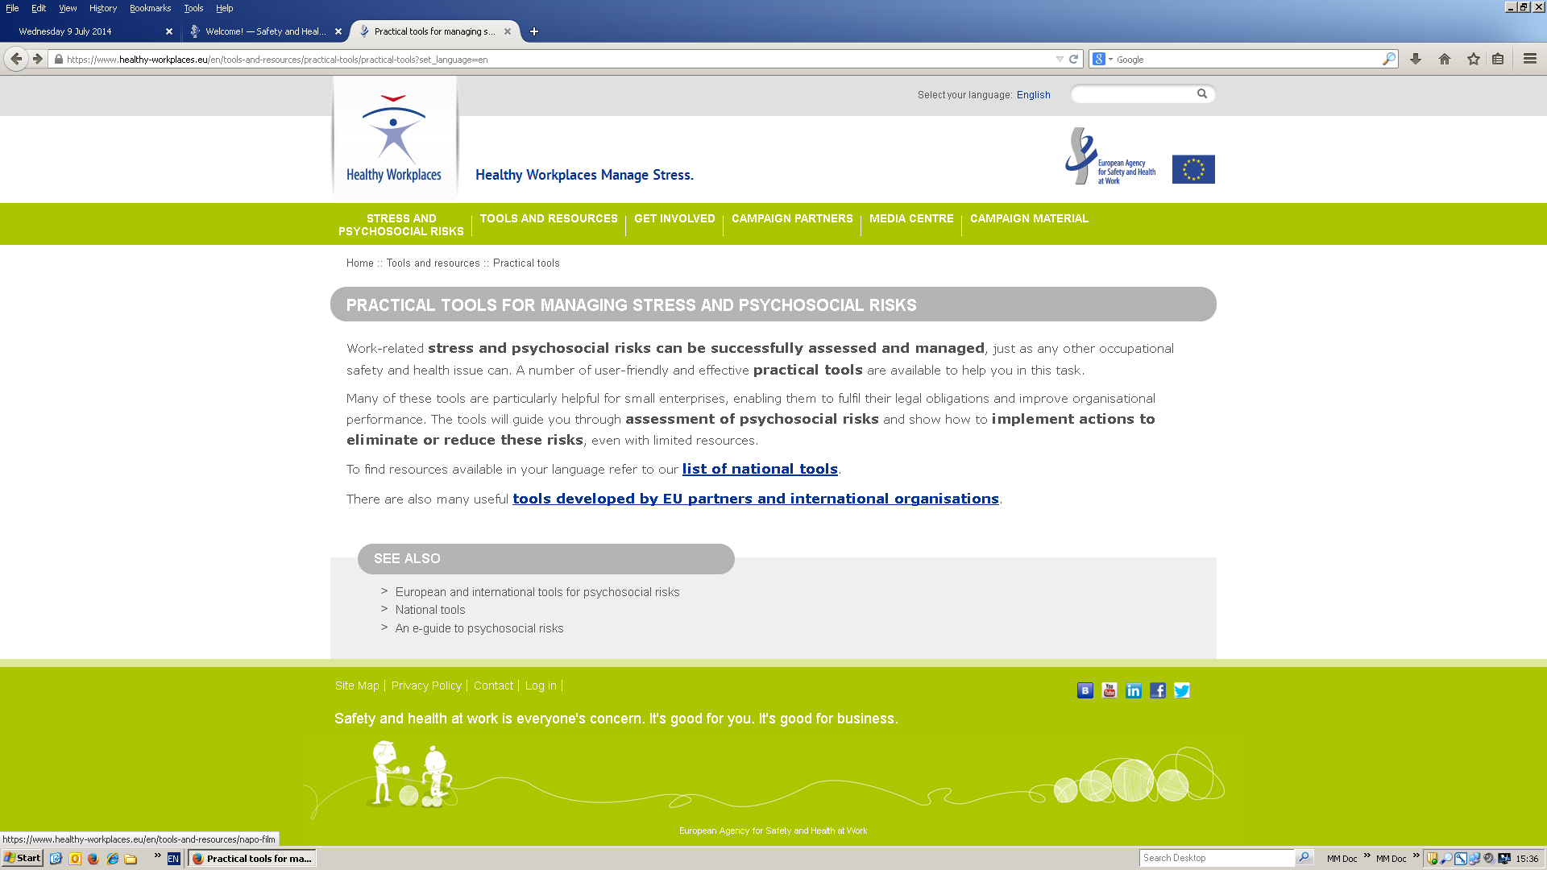
Practical tools (national and international)

Slide 20
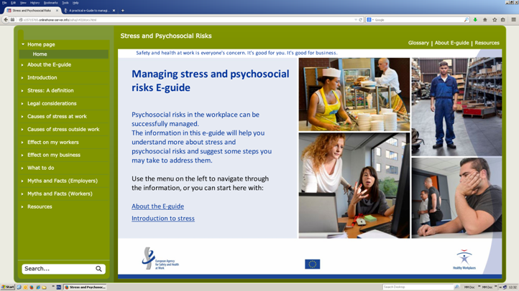
E-guide for managing stress and psychosocial risks
Explains work-related stress and psychosocial risks, their causes and consequences
Gives practical examples of actions that fit small companies
Addresses concerns and misconceptions
Directs to national resources
30 national versions
available
https://www.healthy-workplaces.eu/en/tools-and-resources/a-guide-to-psychosocial-risks

Slide 21

Reports – facts and figures
‘Psychosocial risks in Europe: prevalence and strategies for prevention’
https://osha.europa.eu/en/publications/reports/psychosocial-risks-eu-prevalence-strategies-prevention/view
‘Calculating the costs of stress and psychosocial risks at work’
https://osha.europa.eu/en/publications/literature_reviews/calculating-the-cost-of-work-related-stress-and-psychosocial-risks/view
Facts and figures: ESENER survey
https://osha.europa.eu/en/esener-enterprise-survey/enterprise-survey-esener

Slide 22
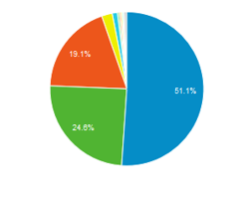






Social Media
  Reaching a bigger audience helps to spread HWC message
        High growth of the audience in Social Media since 2014:
The main social channels 94.8% of the visits from social media to the HWC website are Facebook, Twitter and Linkedin
Facebook
Twitter
Linkedin
Youtube
2,475 fans (Jan14)
18,268 fans (Sept15)
8,535 followers (Jan14)
13,062 followers (Sept15)
3,613 referrers (Feb14)
6,917 referrers (Sept15)
708 subscribers (Jan14)
1,448 subscribers (Sept15)

Slide 23
And finally.... some more numbers
37 EU-OSHA focal points in EU, EEA and candidate countries
800 individual focal point members
102 Official Campaign Partners
1,1 million information products distributed
400 000 promotional items distributed
25 languages for web and publications
1 162 media clippings
365 000 web visits

Slide 24
Forthcoming events
EU-OSHA Healthy Workplaces Campaign 2014-15

Slide 25

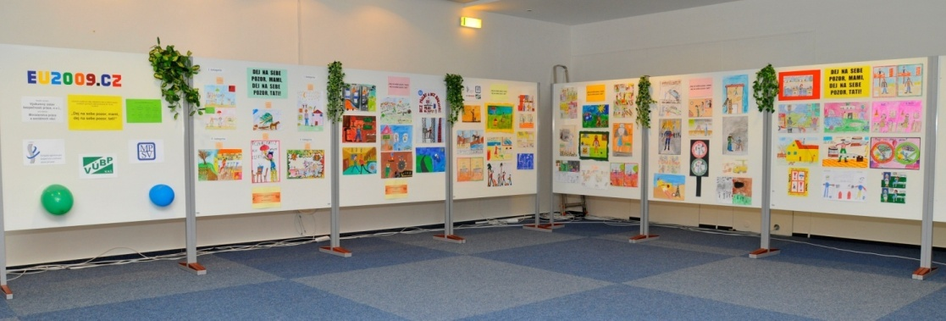
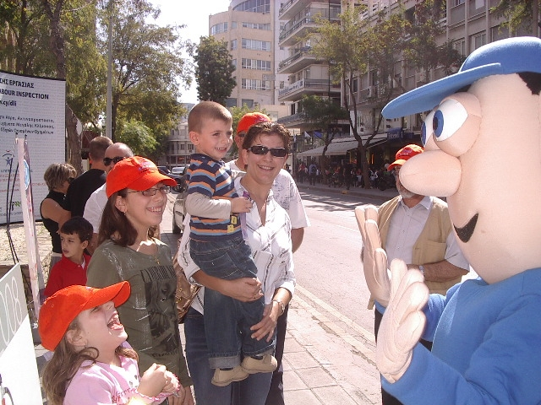
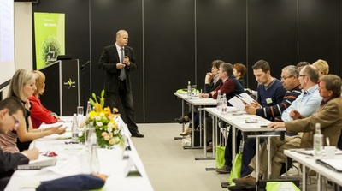
European Week
Hundreds of Campaign events all around Europe
  Conferences, workshops, trainings, exhibitions, etc.

Slide 26

Healthy Workplaces Summit 2015

Slide 27

Thank You!
www.healthy-workplaces.eu

