Slide 1
8th Joint US/EU Conference on Occupational Safety and Health
Fort Worth, Texas
David Michaels, PhD, MPH Assistant Secretary of Labor for Occupational Safety and Health September 17, 2015
Notes:
Director General Curell,
Dr. Alvarez,
Dr. Weil
Ms. Hersman,
Members of the European Commission,
Advocates from ISNetworld and American Society of Safety Engineers
Fellow delegates,
And other distinguished guests,
It is once again my distinct pleasure to welcome all of you to the 8th US/EU Joint Conference on Occupational Safety and Health. As I look around the room, I am delighted to see so many familiar faces as well as new participants, all of whom share in the belief that no job is a good job unless it's a safe job. We all agree that workers should not have to risk their lives or their health while working to provide for themselves and their families.
Whether we assemble as one group, or break into our individual topics, we are challenged with giving a voice to those we represent, to those we are charged with protecting. We are fortunate to have so many highly regarded experts in each of the three conference topics among our delegates. We have the great opportunity to listen and learn from all of our colleagues and counterparts, pushing the boundaries, facing challenges, offering solutions, all in an effort to save workers’ lives.
In our globalized economy, the world of work is constantly changing, and we must be prepared to analyze and adjust our strategies. These open and honest discussions demonstrate the cooperation between our two countries and stands as an important example of how we can all benefit from protecting workers on both sides of the Atlantic.
Today I’ll touch on our shared challenges and how we can transform our strategies and energize our employees to meet them.

Slide 2
Some of Our Challenges
In the United States, employers record approximately 3 million work injuries every year
This is probably a huge underestimate
The number and rate of injuries, including fatal injuries, are decreasing only slightly from year to year
We know less about, and are probably having an even smaller impact, on work illnesses

Slide 3
WHY IS THIS ACCEPTABLE?

Slide 4
What must we do to dramatically reduce the number of work injuries, illnesses and fatalities occurring in our countries, and across the world, today?

Slide 5
Whatever we are doing now isn’t enough.
What must we to do to change the behavior of millions of employers?

Slide 6
Distribution of Employers, by Commitment to Workplace Safety
Criminal Penalties
Inspections & Civil Penalties
Compliance Assistance & Consultation
Recognition Programs
NUMBER OF EMPLOYERS
SVEP
LITTLE
COMMITMENT TO SAFETY
GREAT

Slide 7
Distribution of Employers, by Workplace Safety Culture
Dysfunctional
Reactive Compliant
Proactive
Exemplary
NUMBER OF EMPLOYERS
DANGEROUS
SAFER
GREAT
WORKPLACE SAFETY CULTURE

Slide 8
Distribution of Employers, by Workplace Safety Culture
Dysfunctional
Reactive Compliant
Proactive
Exemplary
NUMBER OF EMPLOYERS
DANGEROUS
SAFER
SAFE
WORKPLACE SAFETY CULTURE

Slide 9
Will Compliance with OSHA Regulations Make My Workplace Safe?
Safer, but not Safe!
Some fatalities and serious injuries will not be prevented by simply complying with OSHA regulations

Slide 10
We need to better understand why some employers make to a commitment to developing an exemplary safety culture – And others don’t.

Slide 11
Are the reasons….
Normative
Economic or Financial
Moral or Personal

Slide 12
OSHA’s New Severe Injury Reporting Rule
Employers are required to report to OSHA:
All work-related fatalities within 8 hours (same as current requirement)
All work-related in-patient hospitalizations of one or more employees within 24 hours
All work-related amputations within 24 hours
All work-related losses of an eye within 24 hours
Notes:
Employers required to report all workplace fatalities within 8 hours and all in-patient hospitalizations, amputations or losses of an eye within 24 hours
Life-saving purpose: Investigating injuries, and learning from them, is one of the most important ways to prevent future injuries from occurring
Already seeing trends that we wouldn’t have otherwise seen

Slide 13
“Human Errors are Consequences not Causes” -James Reason

Slide 14
August 16, 2012
Lawrence “Day” Davis’ first day at work.
Ever.

Slide 15
Notes:
In August, OSHA, in partnerships with NIOSH, issued a set of practices for protecting temporary workers. As you can see from its title, the set of practices are recommended. Some are even Best practices. We have developed this set of practices to be used as guidance to stakeholders - not for enforcement.
The host employer and staffing agency must have effective communication and common understanding of responsibilities to work together to ensure OSH requirements are fully met and temporary employees are protected.
Effective communication between the host and staffing agency may be in the form of a written or verbal contract. It should be understood, however, that the contract’s allocation of responsibilities may not discharge either party’s obligations under the Act.
It is incumbent on both employers to communicate with each other when a worker is injured and determine what measures are to be implemented to prevent future injuries from occurring. Communication between host employer and staffing agency is of fundamental importance in this regard.
The extent of the obligations each employer has will vary depending on workplace conditions and may be clarified by their agreement or contract. Their duties will sometimes overlap. The staffing agency or the host may be particularly well suited to ensure compliance with a particular requirement, and may assume primary responsibility for it. For example, staffing agencies might provide general safety and health training applicable to many different occupational settings, while host employers provide specific training tailored to the particular hazards at their workplaces. If the staffing agency has a long-term, continuing relationship with the temporary worker, it may be best positioned to comply with requirements such as audiometric testing or medical surveillance. The host employer, in turn, would be the primary party responsible for complying with workplace-specific standards relating to machine guarding, exposure to noise or toxic substances, and other workplace-specific safety and health requirements.
The staffing agencies have a duty to diligently inquire and determine what, if any, safety and health hazards are present at their client’s workplaces. For example, if a staffing agency is supplying workers to a host where they will be working in a manufacturing setting using potentially hazardous equipment, the agency should take reasonable steps to identify any hazards present, to ensure that workers will receive the required training, protective equipment, and other safeguards, and then later verify that the protections are in place.
It’s not expected that staffing agencies be experts on all industries. For example, if sending workers to a refinery, we don’t expect the staffing agency to go in and conduct their own in-depth job hazard analyses, but they should be at least generally aware of the hazards and communicate with the host to ensure proper protections are in place. We will not be enforcing any stricter requirements than those our regulations currently require.

Slide 16
Why Are Temp Workers At High Risk of Injury?
New workers are at increased risk of injury.
Notes:
In August, OSHA, in partnerships with NIOSH, issued a set of practices for protecting temporary workers. As you can see from its title, the set of practices are recommended. Some are even Best practices. We have developed this set of practices to be used as guidance to stakeholders - not for enforcement.
The host employer and staffing agency must have effective communication and common understanding of responsibilities to work together to ensure OSH requirements are fully met and temporary employees are protected.
Effective communication between the host and staffing agency may be in the form of a written or verbal contract. It should be understood, however, that the contract’s allocation of responsibilities may not discharge either party’s obligations under the Act.
It is incumbent on both employers to communicate with each other when a worker is injured and determine what measures are to be implemented to prevent future injuries from occurring. Communication between host employer and staffing agency is of fundamental importance in this regard.
The extent of the obligations each employer has will vary depending on workplace conditions and may be clarified by their agreement or contract. Their duties will sometimes overlap. The staffing agency or the host may be particularly well suited to ensure compliance with a particular requirement, and may assume primary responsibility for it. For example, staffing agencies might provide general safety and health training applicable to many different occupational settings, while host employers provide specific training tailored to the particular hazards at their workplaces. If the staffing agency has a long-term, continuing relationship with the temporary worker, it may be best positioned to comply with requirements such as audiometric testing or medical surveillance. The host employer, in turn, would be the primary party responsible for complying with workplace-specific standards relating to machine guarding, exposure to noise or toxic substances, and other workplace-specific safety and health requirements.
The staffing agencies have a duty to diligently inquire and determine what, if any, safety and health hazards are present at their client’s workplaces. For example, if a staffing agency is supplying workers to a host where they will be working in a manufacturing setting using potentially hazardous equipment, the agency should take reasonable steps to identify any hazards present, to ensure that workers will receive the required training, protective equipment, and other safeguards, and then later verify that the protections are in place.
It’s not expected that staffing agencies be experts on all industries. For example, if sending workers to a refinery, we don’t expect the staffing agency to go in and conduct their own in-depth job hazard analyses, but they should be at least generally aware of the hazards and communicate with the host to ensure proper protections are in place. We will not be enforcing any stricter requirements than those our regulations currently require.

Slide 17
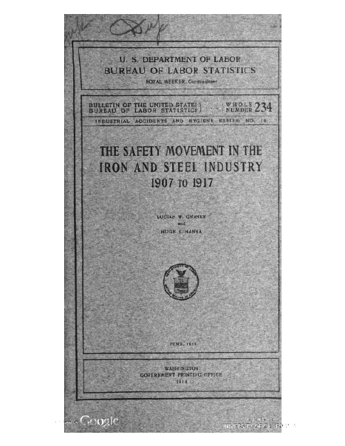

Slide 19
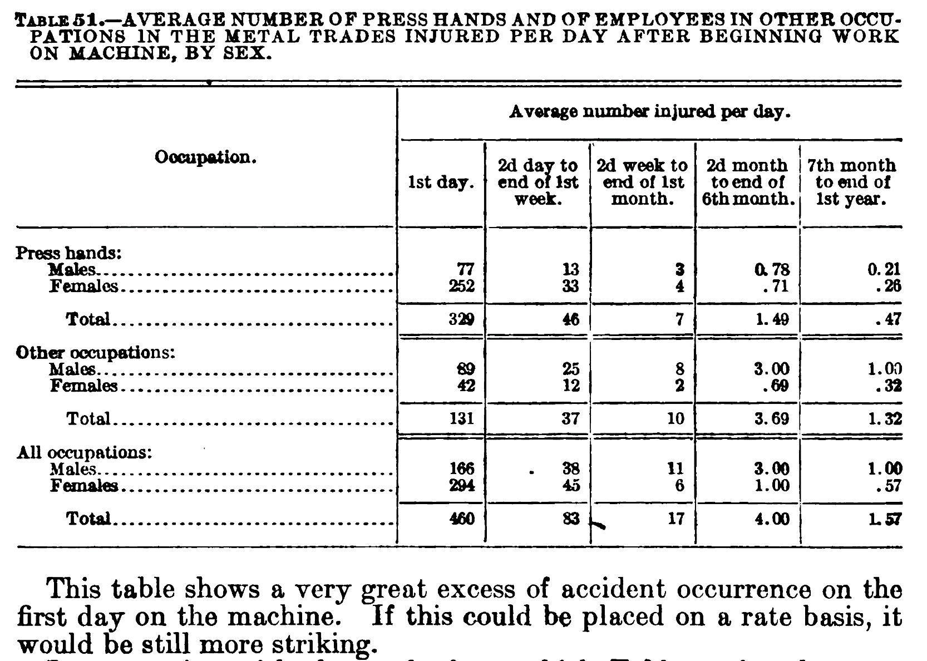
Source: U.S. Dept. of Labor/Bureau of Labor Statistics: Safety Movement in Iron and Steel Industry 1907-1917

Slide 20
Why Are Temp Workers At High Risk of Injury?
New workers are at increased risk of injury.
Host employers don’t have the same commitment to temporary employees as to permanent ones.
Employer who bears the risk of the injury (temp agency) does not control safety and health investment.
Notes:
In August, OSHA, in partnerships with NIOSH, issued a set of practices for protecting temporary workers. As you can see from its title, the set of practices are recommended. Some are even Best practices. We have developed this set of practices to be used as guidance to stakeholders - not for enforcement.
The host employer and staffing agency must have effective communication and common understanding of responsibilities to work together to ensure OSH requirements are fully met and temporary employees are protected.
Effective communication between the host and staffing agency may be in the form of a written or verbal contract. It should be understood, however, that the contract’s allocation of responsibilities may not discharge either party’s obligations under the Act.
It is incumbent on both employers to communicate with each other when a worker is injured and determine what measures are to be implemented to prevent future injuries from occurring. Communication between host employer and staffing agency is of fundamental importance in this regard.
The extent of the obligations each employer has will vary depending on workplace conditions and may be clarified by their agreement or contract. Their duties will sometimes overlap. The staffing agency or the host may be particularly well suited to ensure compliance with a particular requirement, and may assume primary responsibility for it. For example, staffing agencies might provide general safety and health training applicable to many different occupational settings, while host employers provide specific training tailored to the particular hazards at their workplaces. If the staffing agency has a long-term, continuing relationship with the temporary worker, it may be best positioned to comply with requirements such as audiometric testing or medical surveillance. The host employer, in turn, would be the primary party responsible for complying with workplace-specific standards relating to machine guarding, exposure to noise or toxic substances, and other workplace-specific safety and health requirements.
The staffing agencies have a duty to diligently inquire and determine what, if any, safety and health hazards are present at their client’s workplaces. For example, if a staffing agency is supplying workers to a host where they will be working in a manufacturing setting using potentially hazardous equipment, the agency should take reasonable steps to identify any hazards present, to ensure that workers will receive the required training, protective equipment, and other safeguards, and then later verify that the protections are in place.
It’s not expected that staffing agencies be experts on all industries. For example, if sending workers to a refinery, we don’t expect the staffing agency to go in and conduct their own in-depth job hazard analyses, but they should be at least generally aware of the hazards and communicate with the host to ensure proper protections are in place. We will not be enforcing any stricter requirements than those our regulations currently require.

Slide 21
Notes:
Despite the decades-old legal requirement that employers provide workplaces free of serious hazards, every year more than three million workers are seriously injured and thousands more are killed on the job.
We are all aware of the serious and growing problem of income inequality in this country and many of us are working on ways to address this serious problem. But we’re learning that successfully addressing income inequality is more than just raising the minimum wage – we also have to make workplaces safer.
Our recent report, available at www.osha.gov, addresses this issue.

Slide 22
Who bears the cost of worker injuries?
Notes:
Many people still suffer under the illusion that when a worker gets hurt, workers compensation then makes them whole – covering their medical expenses and any lost income. But in reality, changes in state-based workers' compensation insurance programs have made it increasingly difficult for injured workers to receive the full benefits to which they are entitled.
Workers’ comp only covers 20%; workers and families shoulder most of burden (more than 60%) and subsidize employers failing to make workplaces safe
Prevention is the answer; employers must pay their fair share to incentivize

Slide 23
Protecting Poultry Processing Workers

Slide 24
