Slide 1
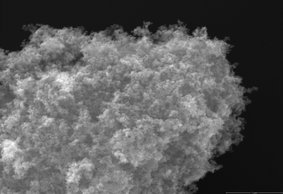
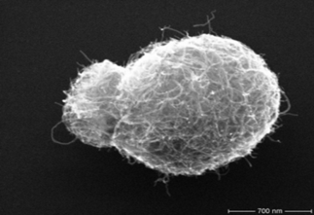
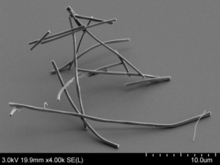




Nanomaterials:
Grouping approach and
OSH reference values
Dr. Rolf Packroff
Scientific Director of the Division
„Hazardous substances and biological agents"
BAuA – Federal Institute for Occupational Safety and Health, Dortmund (Germany)

Slide 2


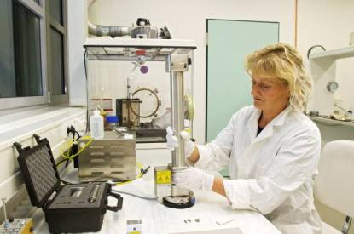

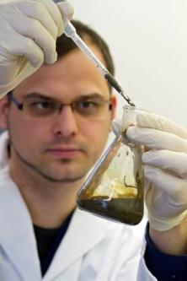

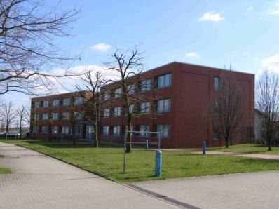
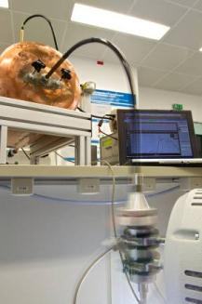

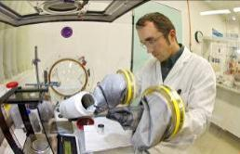
Research, Development, Policy, Transfer-to-practice
Federal Ministry
of Labour and
Social Affairs
The Federal Institute for Occupational Safety and Health (BAuA) as
governmental research institution holds a key position in creating
a safe and healthy work environment
Berlin
Chemnitz
Dortmund
Dresden
www.baua.de
Bilder: BAuA / Vox / Völkner
http://www.ginkgomaps.com/
Notes:
baua_vorlagen.ppt
baua_vorlagen.ppt
Musterseite:
Standard-Text,
1-spaltig + Bild

Slide 3

From 10 years of OSH research on safety and health
of nanomaterials, we now know that ...
inhalation is the most important exposure route at the workplace,
nanomaterials are not hazardous per se,
there is a broad span of health hazards, which can be characterised by well-known principles of the chemical and the particle toxicology,
for significant differences in the potency of corresponding health effects, bio-persistence and morphology of released particles are of higher relevance than their nano dimension,
the potential for release of respirable particles differs from material to material and is not predictable,
in workplace air most particles from nanomaterials agglomerate or aggregate to microscaled entities.

Slide 4
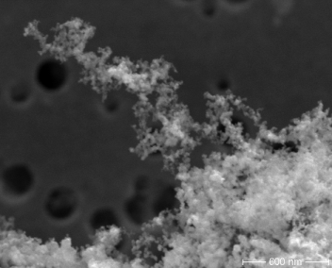

Nanomaterials grouping approach for OSH
Granular Biopersistent Particles (GBP)
respirable particles without specific toxicity (low solubility, chemically inert)
hazards: inflammation of lung tissue, lung cancer, ....
potency of toxic effects is relatively low and depends on the ...
bio-persistence
density of a (solid) material
volume of agglomerates/aggregates from
nanomaterials (“popcorn effect”)
are released at workplaces from
dusty materials (incl. nanomaterials)
combustion processes
machinable techniques (e.g. grinding)
nano TiO₂
1 µm
600 nm

Slide 5

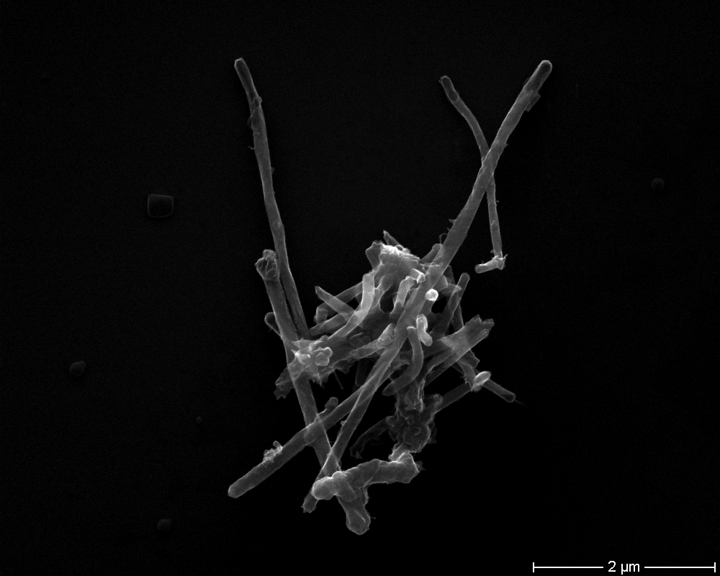
Nanomaterials grouping approach for OSH
Fibrous biopersistent particles (WHO fibres)
nano-
titanium-dioxide
fibres
respirable fibres with a high aspect-ratio (HARN > 3:1), diameter below 3 microns, length above 5 microns
hazards: asbestosis, lung cancer, mesothelioma, ....
potency of toxic effects maybe very high
and depends on the ...
fibre biopersistence
fibre rigidity
are released at workplaces from
asbestos (and other fibrous minerals)
man-made mineral fibres (MMMF)
other fibrous materials
machinable techniques (e.g. grinding of CFC)
rigid
MWCNT
5 µm

Slide 6
Nanomaterials grouping approach for OSH
Materials with a specific (chemical) toxicity
low solubility
high solubility
O
e. g. Cd²⁺
HC CH₂
...loose their particle
properties in the body after a short period of time
... release
toxic ions
... have
reaktive
functional
groups
Hazards can be
read across from
corresponding
bulk materials
... pose catalytic activity
Examples: some types of
amorphous nano-silica
Examples: nano silver, nano nickel

Slide 7
OSH risk assessment
fibres: respirable, rigid, bio-persistent
particles: respirable, bio-persistent
low-emission materials
non-toxic soluble materials
6

Slide 8
Precautionary principle
risk
fibres (respirable, rigid, bio-persistent)
particles (respirable, bio-persistent)
uncertainty of risk assessment
low-emission materials
growth of evident scientific knowledge
(e.g. on health effects from nanomaterials)
2015

Slide 9

Regulatory Framework
Framework directive:
Safety and health at work
89/391/EC
OSH Law
Chemical agents directive (CAD)
98/24/EC
Hazardous Substances
Ordinance

Slide 10
German Regulatory Framework
OSH Law
(parliament)
hard
Hazardous Substances Ordinance
(government, Ministry for labour and social affairs)
Technical rules for hazardous substances (Committee on Hazardous Substances)
Guidance documents and toolkits
(authorities, stakeholders)
soft

Slide 11
German OSH regulation
related to nanomaterials
Hazardous Substances Ordinance
Specific demands for Particulate Hazardous Substances (incl. nanomaterials)
Reference values (based on grouping approach)
granular, biopersistent particles GBP (TRGS 900): 1.25 mg/m³ (respirable fr.)
Hazardous Substances Committee
Announcement 527 „Manufactured nanomaterials“ (recommendations for
risk management based on grouping approach)
GBP from manufact. nanomaterials (BekGS 527): 0.5 mg/m³ (respirable fr. )
nanomaterials with spec. toxicity without OEL (BekGS 527): 0.1 mg/m³ (res. fr.)
biopersistent, fibrous nanomaterials (BekGS 527): 0.01 F/ml (WHO fibres)
Precautionary approach for risk management of chemical agents with lacking
basic data on toxicity

Slide 12
Control strategies (dusty materials)
(1: basic OSH hygiene, 2: emission control, 3: closed system, 4: expert advice)
air concentrationrange | hazard group (EMKG) | reference value | quantity: g (lab) | quantity: kg (start-up) | quantity: t (industry)
1 – 10 mg/m³ | A | GBP 1.25 mg/m³ | 1 | 2 | 2
0.1 – 1 mg/m³ | B | nano-GBP 0.5 mg/m³ | 1 | 2 | 3
0.01 – 0.1 mg/m³ | C | nano spec. Toxicity < 0.1 mg/m³ | 2 | 3 | 3
biopersistent WHO-fibres | E | rigid WHO- nanofibres 10.000 F/m³ | 4 | 4 | 4
based on a control banding scheme:
Einfaches Maßnahmenkonzept Gefahrstoffe (EMKG) www.baua.de/emkg

Slide 13
Control strategies (low-emission materials)
(1: basic OSH hygiene, 2: emission control, 3: closed system, 4: expert advice)
air concentrationrange | hazard group (EMKG) | reference value | quantity: g (lab) | quantity: kg (start-up) | quantity: t (industry)
1 – 10 mg/m³ | A | GBP 1.25 mg/m³ | 1 | 1 | 1
0.1 – 1 mg/m³ | B | nano-GBP 0.5 mg/m³ | 1 | 1 | 1
0.01 – 0.1 mg/m³ | C | nano spec. Toxicity < 0.1 mg/m³ | 1 | 2 | 2
biopersistent WHO-fibres | E | rigid WHO- nanofibres 10.000 F/m³ | 4 | 4 | 4
based on a control banding scheme:
Einfaches Maßnahmenkonzept Gefahrstoffe (EMKG) www.baua.de/emkg

Slide 14
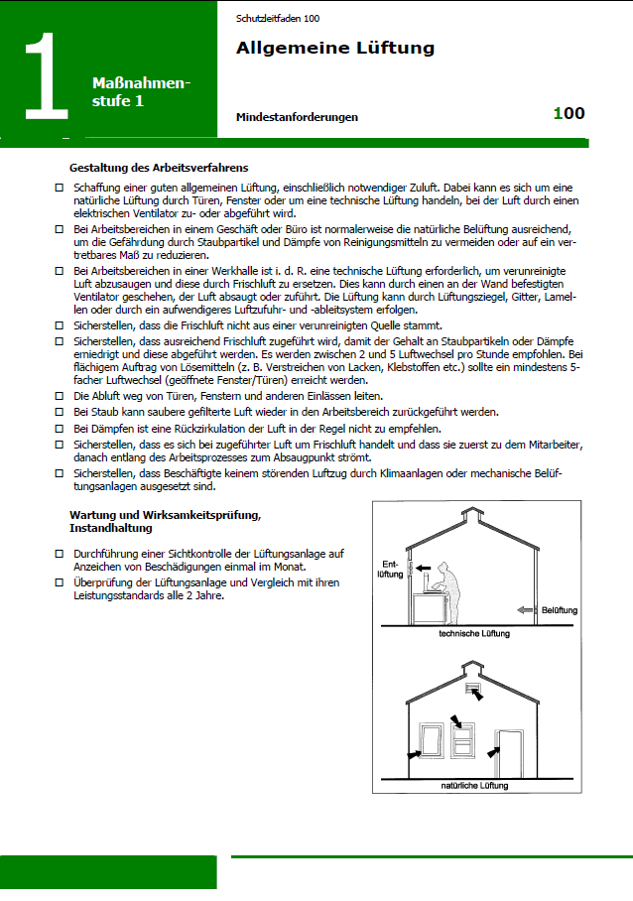
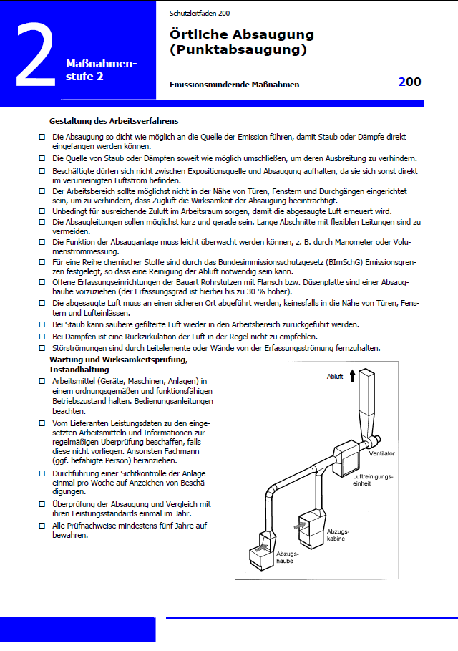
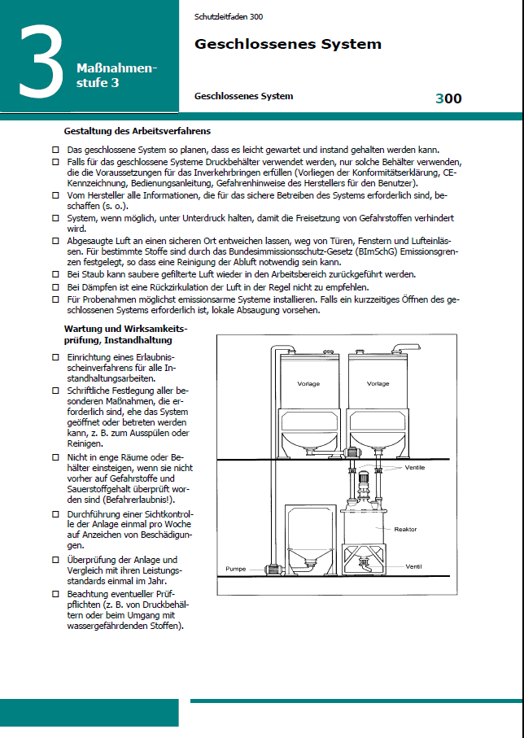



Control guidance sheets (EMKG, HSE)
basic ocupational hygiene
technical controls at source of emission
closed systems

Slide 15

Thank you
packroff.rolf@
baua.bund.de

