Slide 1
Provisional Nano-Reference Limit Values
Kai Savolainen
8th EU-US Joint Conference on Health and Safety at Work, Fort Worth, Texas
17-19 September 2015

Slide 2


CONSUMER
WORKER
STORAGE
TRANSPORTATION
PRODUCTION
WASTE
PRODUCT
AIR
WATER
ENVIRONMENT
DIET

Slide 3
ENM Life Cycle
Nanomaterial
Transport
Research Laboratories
Academic
Commercial
Warehousing/Maintenance
Waste Handling
Start Up/Scale Up Operations
Transport
Warehousing/Maintenance
Manufacturing/Production
Warehousing/Maintenance
Transport
Waste Handling
Incorporation in Products
Maintenance of Products
Manipulation of Products
Application of Products - Medical Delivery
Disposal / End of Life
Schulte et al. [2008]
Recycling

Slide 4
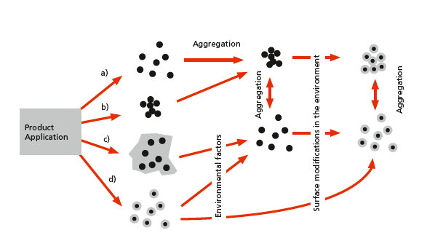

Transformation of ENM aerosol

Slide 5
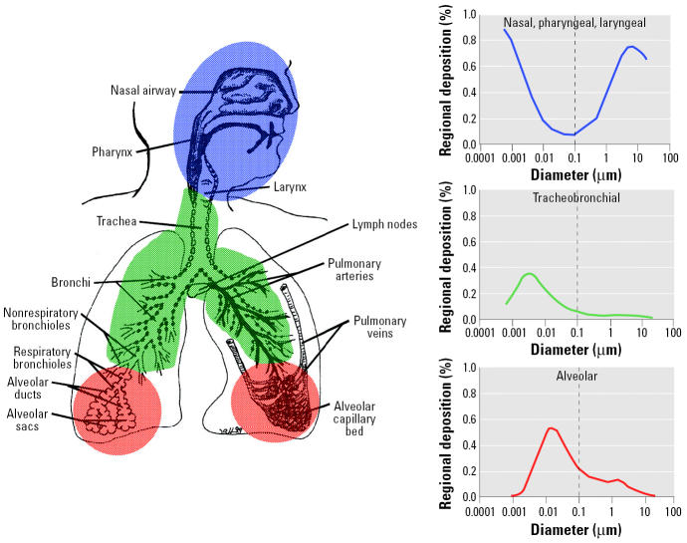
Predicted fractional deposition of inhaled particles
Oberdörster G et al. Environ Health Perspect 2005;113:823-39

Slide 6
The safety knowledge gap challenges development of legislation, regulations
Schematic representation of emergence of nanotechnology products in comparison to generated EHS data (Linkov and Satterstrom: Nanomaterial Risk Assessment and Risk Management, 2008).

Slide 7
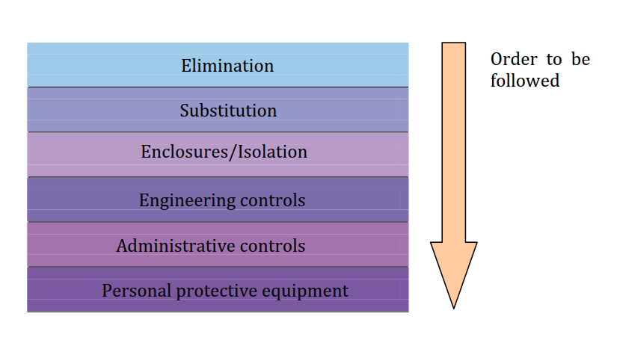
Hierarchy of controls (ISO/TS 12901-1:2012) at workplaces: ENM
EU FP7 SCAFFOLD conclusions2015

Slide 8
ENM Governance: Provisional Nano Reference Values (SER 2012, IFA 2014)
Description | Benchmark level (8 h TWA) | Examples
Rigid, biopersistent nanofibres for which effects similar to those of asbestos are not excluded | 0.01 fibres/cm^{3 *} | Carbon nanotubes, carbon nanofibres, nanocellulose
Biopersistent granular nanomaterial; density >6000 kg/m³ | 20 000 particles/cm³ | Ag, Au, CeO₂, CoO, Fe, Pb, SnO₂
Biopersistent granular nanomaterial; density <6000 kg/m³, size-range 1-100 nm, and nanofibres for which asbestos-like effects are excluded. | 40 000 particles/cm³ | Al₂O₃, SiO₂, TiN, TiO₂, ZnO, nanoclays, dendrimers, polystyrene
*The value is identical to the benchmark exposure limit (BEL) for fibrous nanomaterials proposed by the British Standards Institute (BSI) (BSI 2007). Values are precautionary, not health-based.

Slide 9
CONCLUDING REMARKS
Safer-by design approaches, breakthrough in hazard and exposure – and consequently risk assessment enable trust by consumers, regulators, down-stream industry
Sustainable, safe nanotechnologies and trustworthy applications enable progress and success of utilization of material at nanoscale

Slide 10
Thank you for your attention!
^{Nanosafety Research Centre}
^{www.ttl.fi/nanosafetycentre}
^{nanoinfo@ttl.fi}

