Slide 1

Nanotechnology in the Workplace
September 16-19, 2015
Fort Worth, Texas

Slide 2

Nanotechnology Workgroup Background
Introduced as a topic at the 5th OS&H Conference in Lisbon, 2007
Continued discussion at the 7th OS&H Conference in Brussels, 2012
  Brief Report Generated
  Overarching Principles drafted and agreed to by the workgroup
Detailed discussion at the 8th OS&H Conference in Fort Worth, 2015
  Refresh on the Overarching Principles
  Status check on Recommendations
  Review agenda

Slide 3

Agenda Overview
Co-Chairs: Dr. Kai Savolainen (EU), Dr. Chuck Geraci (US)
Flow of the breakout sessions: Moderator for each session
Presentations, discussion, questions captured by scribe
Summary presented at the end of the conference

Slide 4
Nanotechnology Workgroup: Agenda Overview
Drafted with EU and US input
Key topics selected: not an attempt to cover every topic in the Overarching Principles
Focus is on active discussion and not formal presentations
Thought and discussion starter volunteers from the EU and US
Summary at the end of the Conference

Slide 5
Foundation Document
Draws from the paper generated for the 7th Joint conference
Repeats the major themes
Focus in on reporting and evaluating progress
Continue to identify opportunities to create knowledge
Identify areas for collaboration between the EU and US

Slide 6
Review Outputs of the 7th Conference
Overarching Principles
1. The health of workers should not be undermined by their work with nanomaterials
2. When workers handle nanomaterials, risk assessments must be performed and exposure limited to extent possible
3. There is a need to develop globally harmonized definitions for engineered nanomaterils
4. Transparency and traceability: Workers and employers need to know if engineered nanomaterials are in the workplace and where exposures may occur.

Slide 7
Overarching Principles (Cont.)
5. Apply ‘safe by design’ principles to materials and processes as abest practice to protect workers
6. Continue to identify and refinw well-established Industrial Hygiene practices appropirae for nanotechnology hazards and risks.
7. Develop early warning systems tomonitor worker health: medical screening, monitoring, surveillance, epidemiology
8. Adopt a precautionary approach in the absence of OELs: consider alternatives to OELs: reference values, groupings
9. Develop harmonized exposure assessment measurements and control strategies
10. Worker participation in developing risk management practices

Slide 8
Review Outputs of the 7th Conference
Recommendations
Incorporate principles in laws, regulations, and practices.
Promote sector-specific assessments of exposure potential.
Promote further investigation of hazard potential and comparative potency.
Develop joint database on control solutions.
Develop joint website for workers.

Slide 9
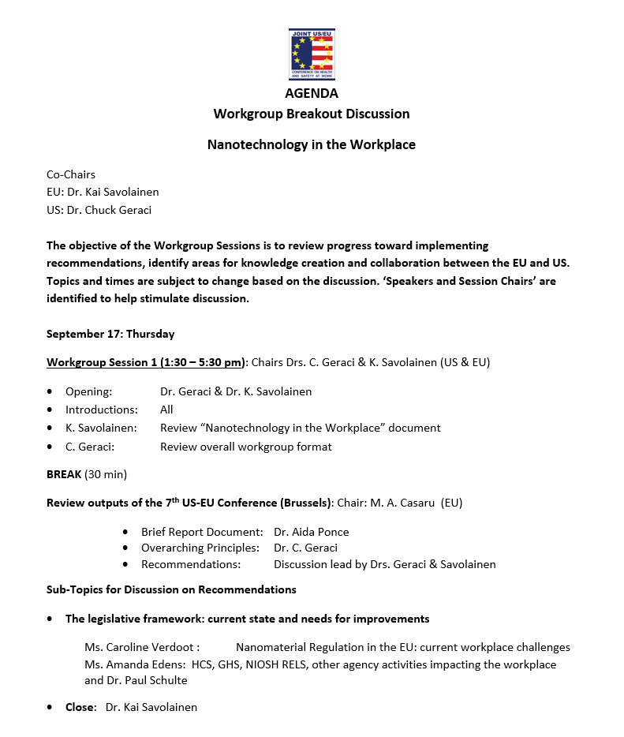
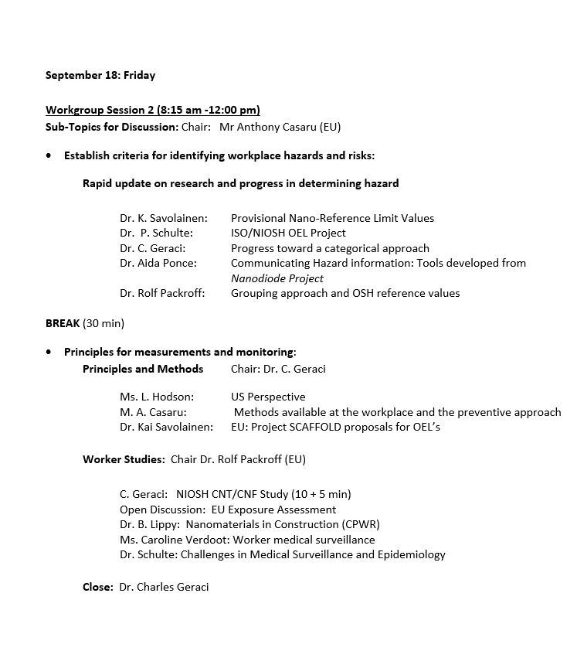
Nanotechnology Workgroup Agenda

Slide 10
Break for Slide Sets

Slide 11
Globally Harmonized Exposure Measurements Workgroup: History
Concept created and agreed to with TNO and NIOSH as initial sponsors: Derk Brouwer and Chuck Geraci at Keystone Conference, CO: July 2010
First Workshop: Zeist, the Netherlands: December, 2010
Second Workshop: Boston, MA, in conjunction with NanOEH5, August 2011
Third Workshop: Helsinki, October 2012, In conjunction with SENN 2012
Fourth Workshop: Nagoya, Japan; In conjunction with NanOEH6, October 2013
Fifth Workshop: Grenoble, France: in conjunction with NanoSafe 2015, November 2015

Slide 12
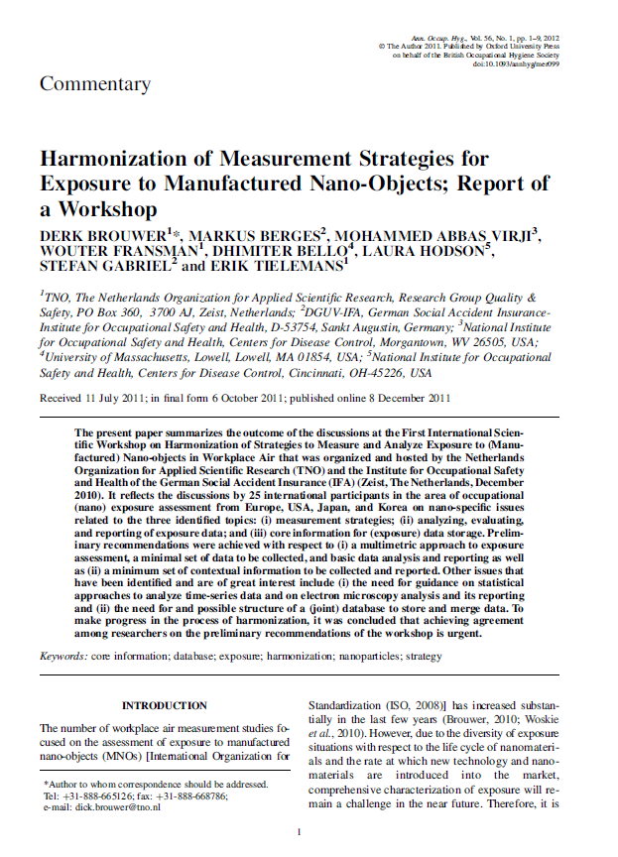
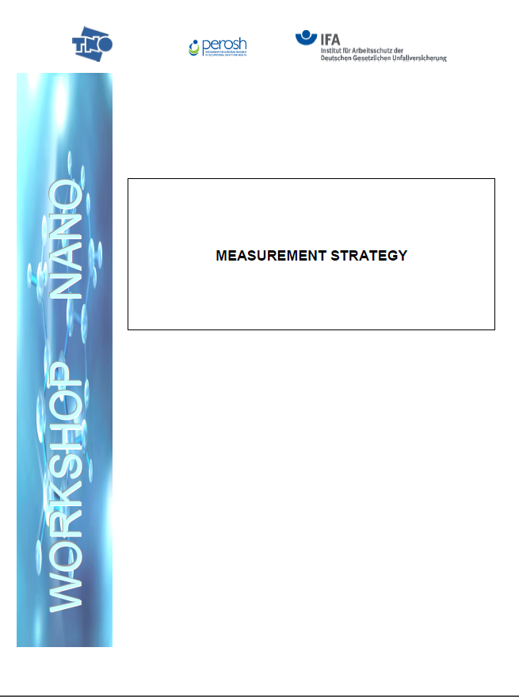
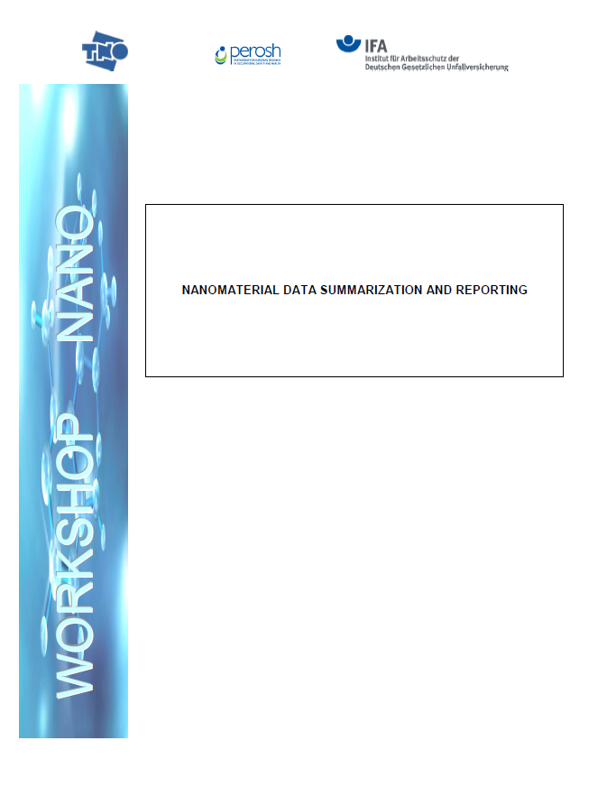

Globally Harmonized Exposure Measurements (cont.)
Summary of 1st Workshop
Three principles introduced at the 2nd Workshop

Slide 13
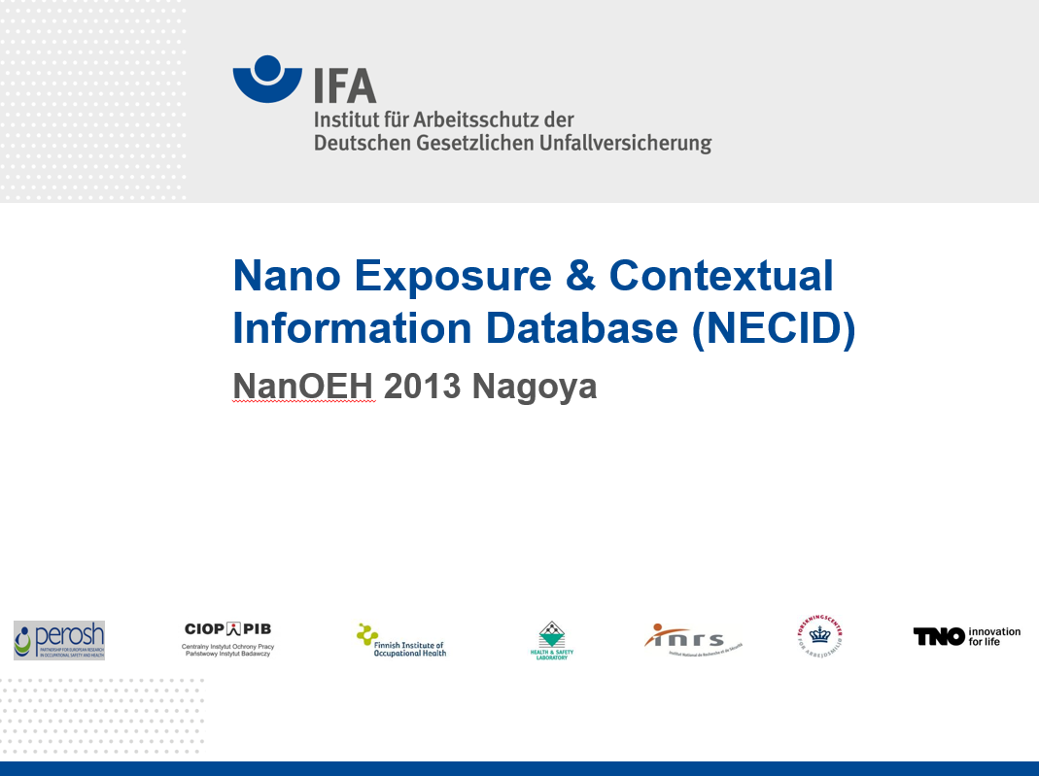
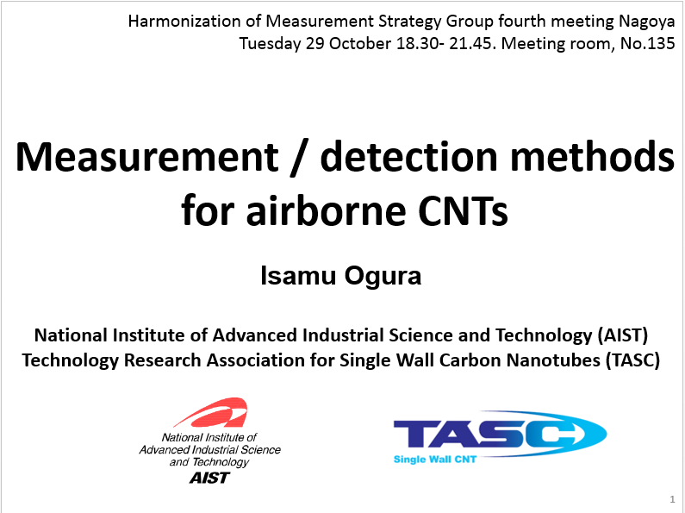
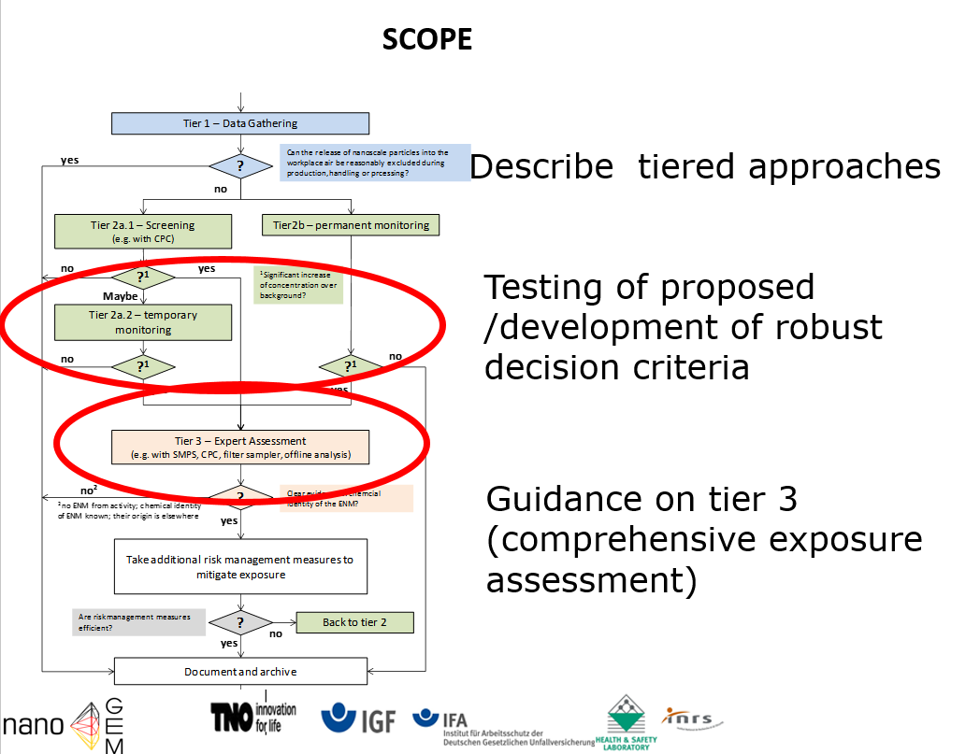
Globally Harmonized Exposure Measurements (cont.)
Key activities at the 4th Workshop in Nagoya, Japan, 2013
Database proposed
Heavy emphasis on CNT
Tiered approach maturing

Slide 14
Globally Harmonized Exposure Measurements (cont.)
Key activities and discussions at he 5th Workshop, Grenoble, France, 2014
The OECD report on Measurement strategy: released
The CEN report on the pre-normative research (testing of decision rules) has been concluded and will be released
The CEN Standard on Inhalation Exposure Assessment has evolved to its 4th draft and continues.
The CEN project on dustiness as a predictive tool is close to the phase of the actual testing of a panel of powders. Collaboration with NIOSH is planned
During SENN2015 (Helsinki, April 2015) a workshop was held on harmonizing release testing (from the perspective of human exposure modelling). A summary of that workshop will be released in late 2015 or early 2016

Slide 15
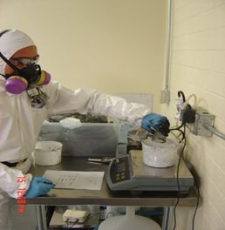
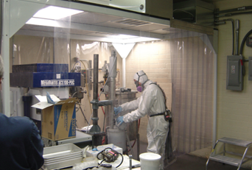
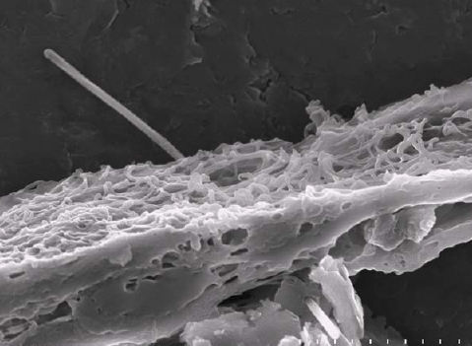
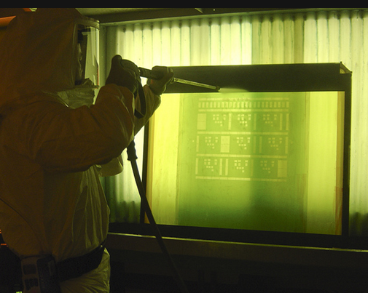
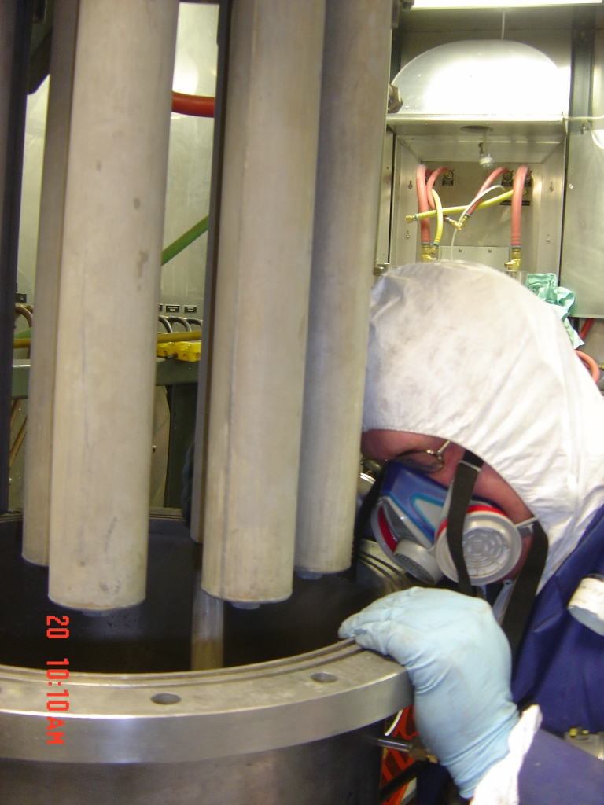
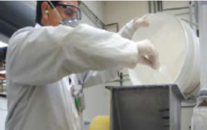
Nanotechnology Research at NIOSH
- A blend of lab and fields projects -

Slide 16
NIOSH Priority Goals for 2015- 2016
Increase understanding of new hazards and related health risks to nanomaterial workers and expand initial findings
Expand field investigations and the creation of guidance on hazards, risks, and risk management approaches for workers, employers, agencies and policy makers.
Support epidemiologic studies for nanomaterial workers including medical and exposure studies
Assess and promote national and international adherence with risk management guidance.
Link to Advanced Manufacturing initiative

Slide 17
Categorical Approach

Slide 18
Benefits of a Categorical Approach
More efficient use of data
Reduced costs and animal use
Increased sample size
Greater robustness of results
Increased biological plausibility for other materials in same mode of action (MOA) category
[OECD, Env/JM/MONO(2007)28]
New guidance on methods for grouping chemicals: OECD, ENV/JM/MONO(2014)4
18

Slide 19
Evidence-based Strategy to Develop OELs & OEBs*
Available Health Hazard & Physical-Chemical Data
Sufficient
Limited (focused)
Minimal
Quantitative Risk Assessment
Structure-Activity & Toxicity Comparison
Analogy or Default
Benchmark particles
Health-Based OEL
Hazard Band / OEB
Measurement & Control
Control Band
* Occupational Exposure Limits & Occupational Exposure Bands
[Adapted from: Schulte et al. 2010; Kuempel et al. 2007, 2012]
Notes:
BMPs are well-characterized particles (PC and tox) for which a health-risk based OEL has been or could be developed, and which provide a point of reference for comparing toxicity of an ENM. This allows using information from data-rich substances to help assess potential hazard of data poor substances with similar PC properties and MOA.

Slide 20
Risk Assessment in Hazard & Control Banding
Standard Set of Assays and Parameters
Physical-chemical properties
Dose to target tissue
Critical Effect & MOA
ATS Assays with ENMs and BMPs
Comparative toxicity & risk of ENMs and benchmark particles
*
<1 µg/m³
1 – 10 µg/m³
10 – 100 µg/m³
100 – 1000 µg/m³
>1000 µg/m³
Closed Systems & Robotics
Containment Systems
Ventilated Enclosures
Local Exhaust Ventilation
General Ventilation
Example of performance-based exposure control bands developed in pharmaceutical industry; 8-hr TWA
concentrations [Naumann et al. 1996; Ader et al. 2005; Zalk & Nelson 2008];
[Adapted from Kuempel et al., JNR 14:1029; 2012]

Slide 21
Possible Mode of Action (MOA) Categories for Nanomaterials
Parameter | Higher solubility particles | Poorly-soluble, low toxicity particles | Poorly-soluble, high toxicity particles | Fibrous particles
Benchmark particle example | Zinc oxide Copper oxide I | Titanium dioxide Carbon black | Crystalline silica Nickel oxide III Chromium oxide III | Carbon nanotubes/fibers Asbestos
Adverse effects, selected | Acute lung effects Systemic toxicity | Lung inflammation, fibrosis, cancer (rats) | Lung inflammation, fibrosis, cancer | Lung fibrosis, cancer, mesothelioma
Mode of action example | Toxic ions reach systemic tissues | Surface area dose of respirable particles | Reactive surface area dose of respirable particles | Biopersistence Migration to pleural Genotoxicity
[Kuempel et al., JNR 14:1029; 2012]

Slide 22
Example Benchmark Particles & Risk-based Exposure Bands: Poorly-Soluble Inhaled Particles
Hazard Rank | Substance | Primary Particle Size | Occupational Exposure Band* (8-hr TWA, µg/m³)
Low | Molybdenum oxide Titanium dioxide (F) | Fine | >1,000
Moderate | Carbon black Diesel exhaust particulate Titanium dioxide (UF) | Ultrafine | 100 – 1,000
High | Nickel oxide | Fine | 10 – 100
Very high | Nickel subsulfide Gallium arsenide | Fine | 1–10
*Assignment based on working lifetime exposures associated with <1/1000 excess risk of lung cancer;
95% LCL estimates extrapolated from rat chronic inhalation studies by NTP.
[Kuempel et al., JNR 14:1029; 2012]

Slide 23
What Data are Available?
New data on nanomaterials in vivo and in vitro studies reported in the literature (e.g., relative hazard ranking)
Existing studies of lung effects from inhaled particles and fibers
  Animal subchronic and chronic inhalation studies
  Occupational lung disease data in workers
Data may be used to identify MOA & compare toxicity
[E. Kuempel, NIOSH/NTRC]

Slide 24
Toxicity and Internal Dose

Slide 25
Nanotoxicology Program: Current Directions
Toxicological Characterization of Emerging Nanomaterials
Mechanisms of Action of Established Biological Outcomes: Fibrosis and Cancer
High Throughput In Vitro Assays for Predicting Toxicity: Mode of Action of Nanomaterials
Occupationally Relevant Exposures/Doses: Partnering With Epidemiology and Industry
Extra-pulmonary Responses to Respiratory Exposure
Biomarkers for Exposure and Biological Outcome
Effect of phys/chem modification on biological response

Slide 26
Nanomaterials Under Investigation in Toxicology
MWCNT
DWCNT
Vapor-Grown CNF
CNT and CNF – 10 US Facilities in
Epidemiology Study
SWCNT
Graphite Nanoplatelets
Graphene Oxide
Elemental Silver
Cerium Oxide
Lanthium and Cobalt Oxides
Nickel Oxide
Iron Oxides
Copper Oxide
Zinc Oxide Spheres and Nanowires
Titanium Dioxide Nanorods
SiO₂ – amorphous and crystalline
Tungstate (particles and rods)
-CaWO4, SrWO4, BaWO4
Tungsten carbide-cobalt
Quantum Dots
Nanocellulose
Natural and Organomodified
Montmorillonite Nanoclay
Boron Nitride Nanotubes
Silicon nanowires
Relevant Dose Initiative
Emerging

Slide 27
Risk Assessment

Slide 28
Nanomaterials Risk Assessment Projects
I. Categorical occupational exposure limits or bands
(OEBs/OELs)
  Evidence-based framework [Kuempel et al. 2012, JNR 14:1029]
  Developing dose-response data sets
  Evaluating statistical methods for comparative potency and classification analyses to develop risk-based categories
  Link to hazard and control banding
Dosimetry modeling of inhaled nanomaterials
  Dose estimation is a key area of uncertainty in nanomaterials risk assessment
  Projects to improve estimates of nanoparticle dose in lungs and other organs
III. Silver Current Intelligence Bulletin – Internal Review

Slide 29
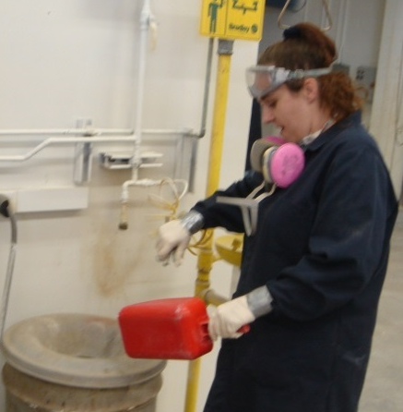
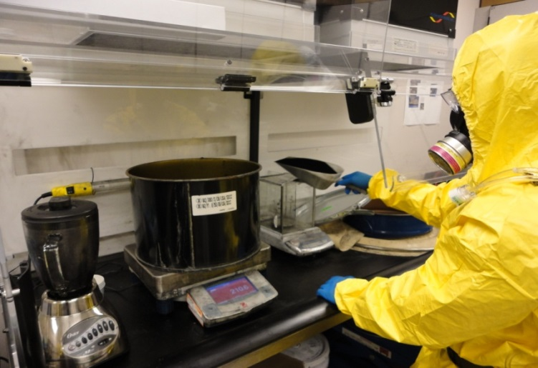
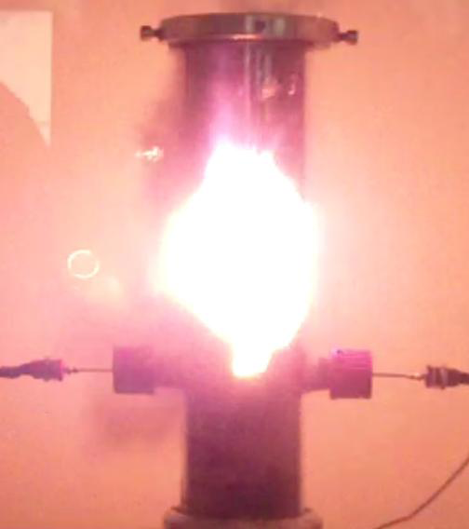
Airborne Dust Generation
Evaluating Physical Hazards
Health Concern
Dustiness
Powder Quantity
Type of Operation
Engineering Controls
Ventilation
Dry Powder Operations
Factors Influencing Airborne Dust Generation
Safety Concern

Slide 30
Exposure Assessment

Slide 31
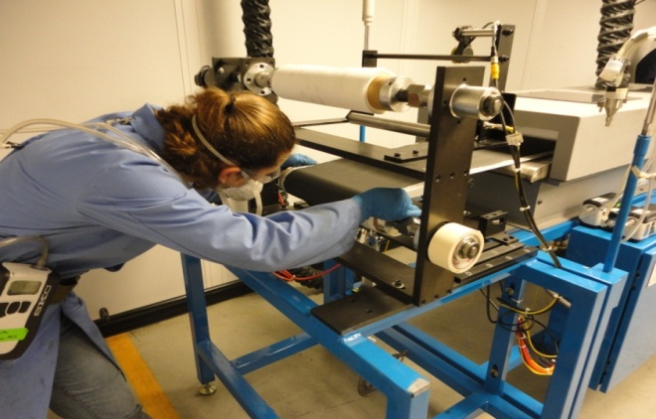
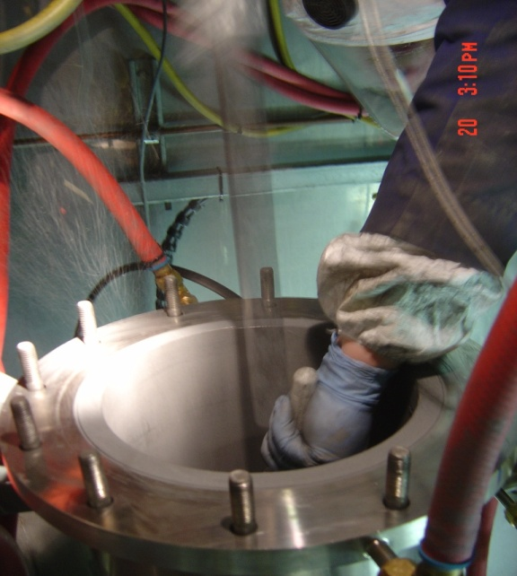
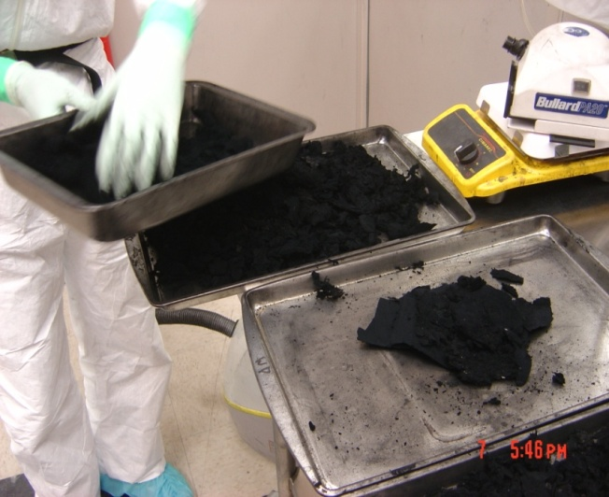


Exposure Assessment in the Real World
Exploratory Research

Slide 32
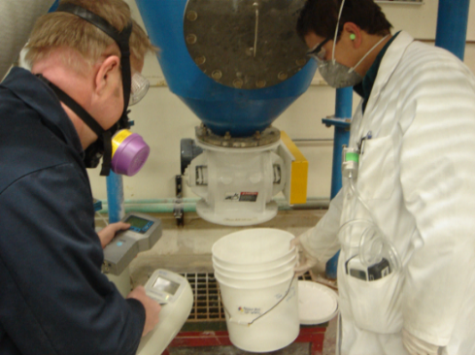

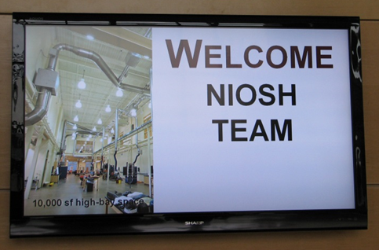
Exposure Assessment
NIOSH Performs On-site Research
To date, 100 visits to 65 different sites
Diversity in sites, materials, and applications
Focused efforts: CNT/CNF, Controls
Evaluate processes and personal exposures
Use and extend existing methods
Partnerships with the private sector is a key to success
Guidance and recommendations given to employers
Summary results published

Slide 33

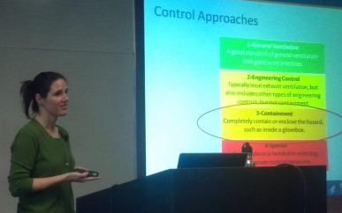
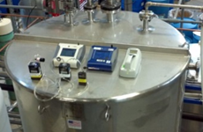
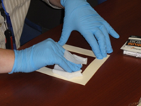
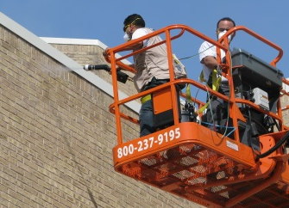
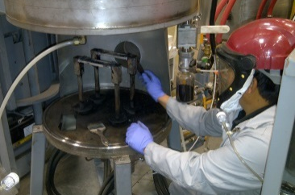
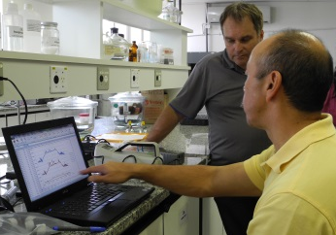
NIOSH Site Studies
Exposure characterizations for a wide variety of materials in multiple industrial processes
  MWCNT & SWCNT
  CNF, Fullerenes, and Graphene
  Silica and Aluminum oxide
  Quantum Dots
  Silver nanowires
  Metal oxides (Mn, Co, Ag, Fe, Al, Cu, Hf, Pd)
  Hafnium and Zirconium
  Nanocellulose crystals and fibrils
  Cellulose Acetate
  Cobalt
  Titanium Dioxide

Slide 34
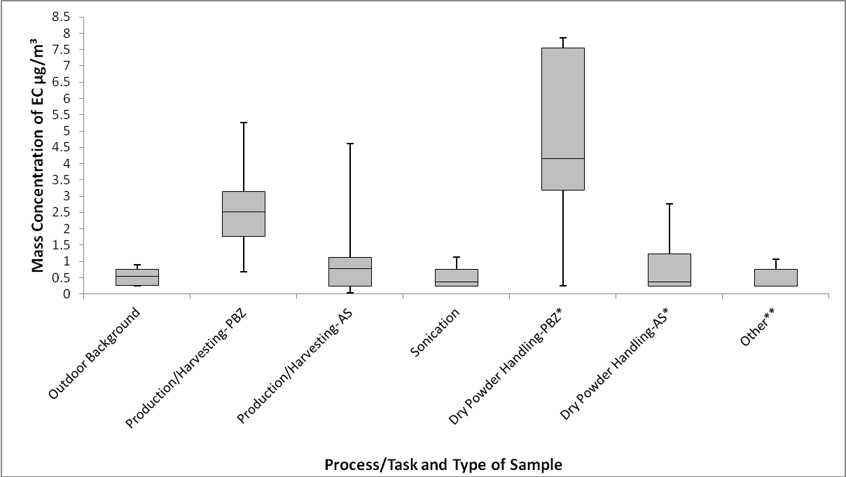

Variation in elemental carbon exposure by task
(Dahm et al., J Occ Environ Hyg)
NIOSH REL
**CNT Waste collection, General office work, Milling CNT composite, Sieving and Spray Coating

Slide 35
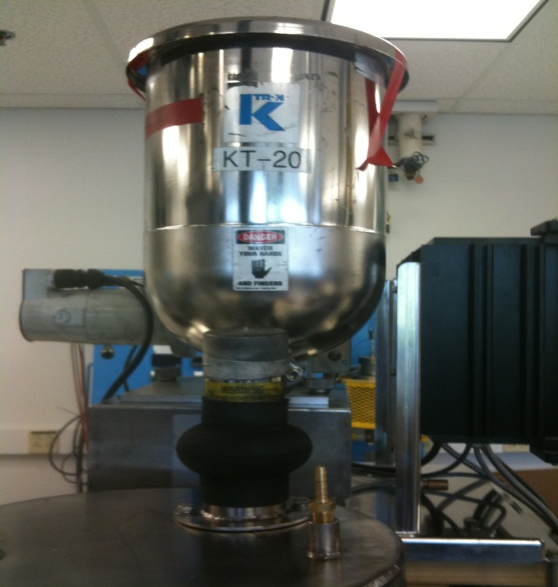

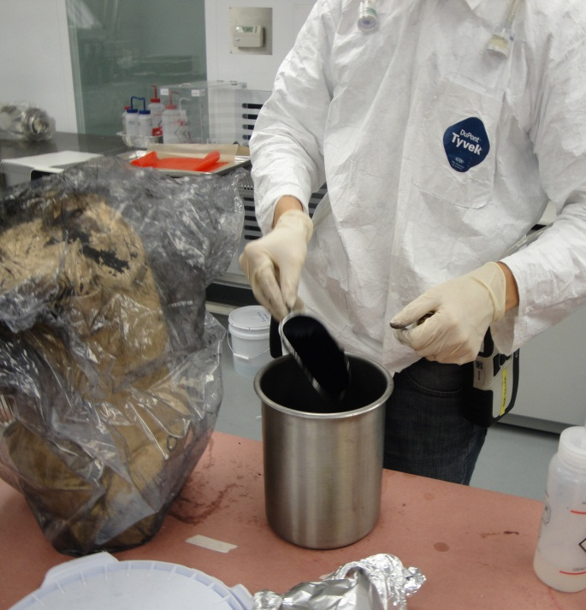
Specific Task Evaluation: Dry Powder Handling
Process: Extrusion
Task: Weighing MWCNT
Volume: 1 kg
Duration of Sample: 112 min
Exposure Concentration=
3.19 μg/m³
Process: Wet Shipping
Task: Weighing MWCNT
Volume: 7.7 kg
Duration of Sample: 269 min
Exposure Concentration=
0.3 μg/m³
Process: Resin Formulation
Task: Weighing CNF/MWCNT
Volume: 100-200 g
Duration of Sample: 178 min
Exposure Concentration=
7.54 μg/m³
Notes:
Scenario 1- Exposure Controls and PPE- Negative pressure containment room, Chemical fume hood/Safety glasses, ½ face respirator, lab coat, nitrile gloves
Scenario 2- Exposure Controls and PPE- HEPA filtered negative pressure containment room, Powder hood/Nitrile gloves, lab coat, safety glasses, TYCHEM suit, ½ face respirator with stacked organic P-100 cartridge, boot coverings
Scenario 3- Exposure Controls and PPE- Clean Room, Chemical Fume Hoods/Latex gloves, ½ face respirator and tyvek smock

Slide 36
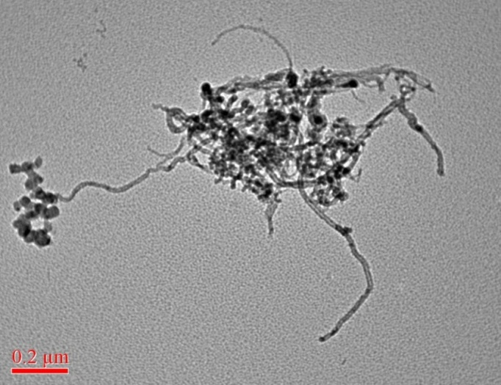
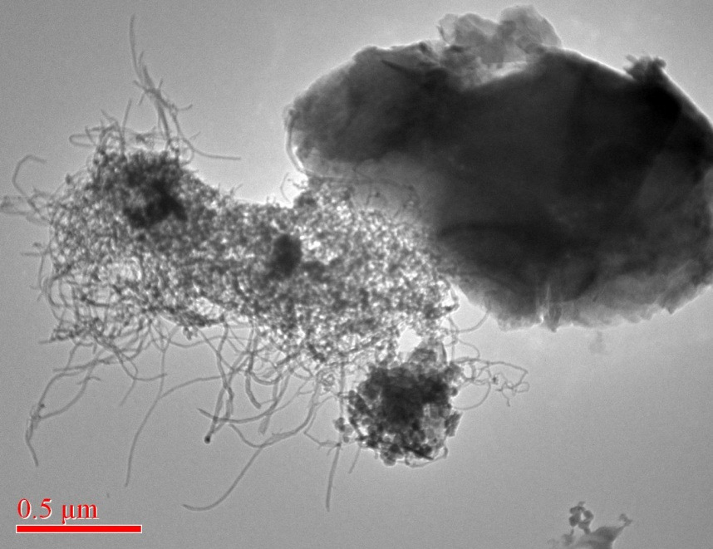
Exposure Assessment/Tox Challenges
Two structures measured as EC. Same hazard?
Images from personal breathing zone samples from CNT manufacturing (Dahm et al. 2012)
Images courtesy of Joe Fernback, NIOSH

Slide 37
:
Epidemiology and Surveillance

Slide 38
Connecting the Key Exposure Assessment Elements
Epidemiology
Exposure Metrics
Biomarkers
Exposure Assessment
Toxicology Assessment
Dose metrics

Slide 39
Controls and PPE

Slide 40
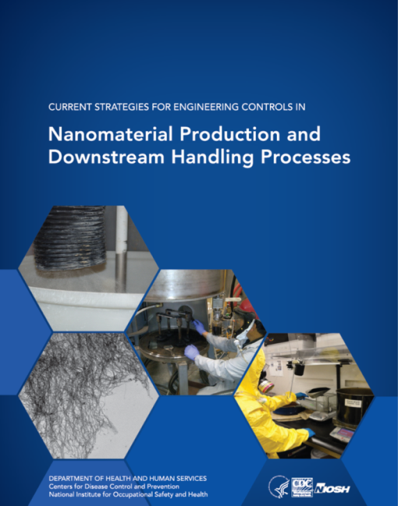
Results/Guidance for Engineering Controls
In 2013, released “Current Strategies for Engineering Controls in Nanomaterial Handling and Downstream Processes”
  Provides guidance regarding approaches and strategies to protect workers by using available engineering controls for engineered nanomaterials in the workplace.
  Covers common processes including material weighing and handling, reactor harvesting and cleaning, bag dumping and large-scale material handling/transfer
  http://www.cdc.gov/niosh/docs/2014-102/
In 2015, published a summary of control evaluations at 3 carbonaceous nanomaterial plants
Heitbrink, WA. J Occup Environ Hyg. 2015;12(1):16-28.

Slide 41
Draft-Do Not Cite

Slide 42
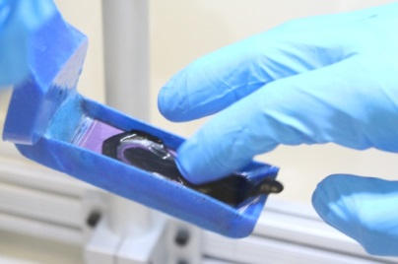
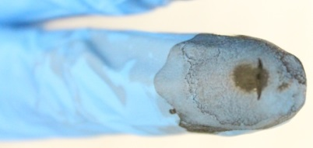
Glove Study: progress update
Completed determination of glove damage time for ENM dry powder and slurry
  Dry powders: > 2 hours for both ENMs
  Slurry: two hours for SWCNT; ≤10 minutes for TiO₂
    Increasing slurry concentration increased the damage time for both ENMs due to smooth effect (e.g., particles filling sandpaper’s rough surfaces)

Slide 43
Guidance

Slide 44






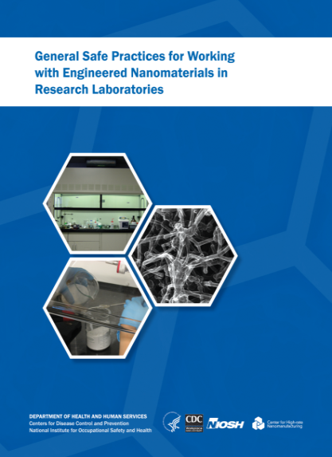


Nanotechnology Guidance Documents
Draft
Draft
http://www.cdc.gov/niosh/topics/nanotech/
Notes:
You can look at the number printed and the number disseminated

Slide 45
NIOSH Global Leadership
Collaboration with and leadership in government-level international organizations (United Nations, Organization for Economic Cooperation and Development)
Participation and leadership in international standards developing organizations (International Organization for Standardization, ASTM International)
Participation and leadership in multi-stakeholder organizations (International Council On Nanotechnology, International Alliance for NanoEHS Harmonization, Global Measurement Harmonization Workgroup, NanoRelease)

