Slide 1
Maintaining Safe Production
Susan Mackenzie
Health and Safety Executive UK
Director - Hazardous Installations

Slide 2
Maintaining Safe Production
$50

Slide 3
Maintaining Safe Production
Cut exploration
Reduce manning
Reduce training
Reduce maintenance
Focus on today, not tomorrow?

Slide 4
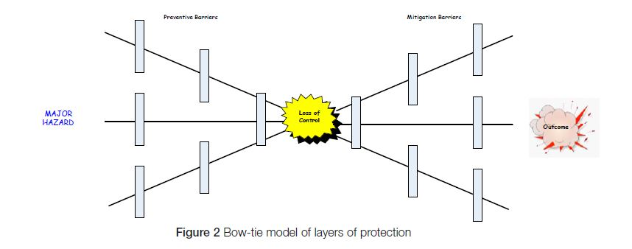
Bow Tie Model

Slide 5
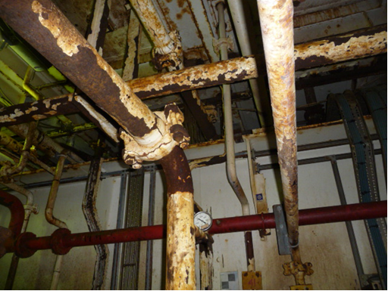

Slide 6
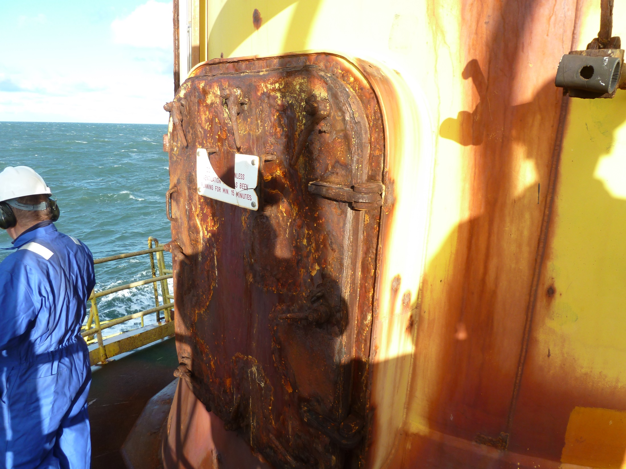

Slide 7
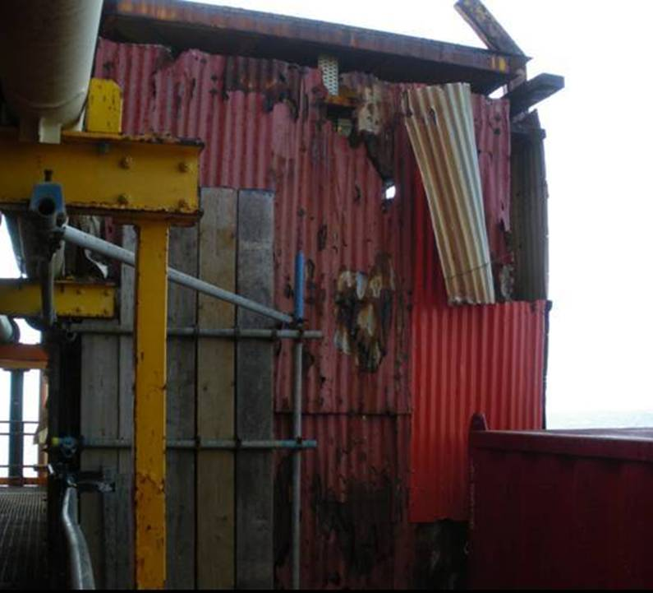

Slide 8
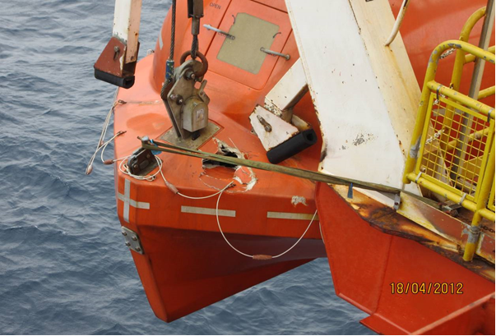

Slide 9
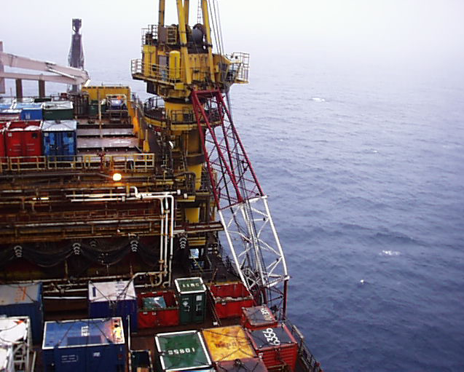

Slide 10
UKCS Safety Critical Backlog

Slide 11
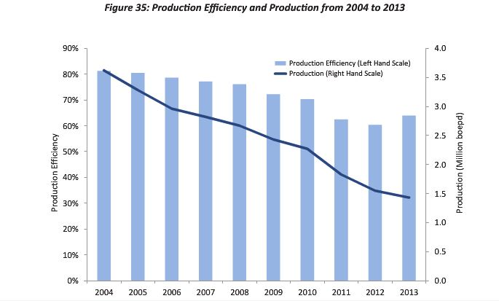
Production Efficiency 2004-2013 UKCS

Slide 12
Layers of Protection

Slide 13
Accidents Waiting to Happen
Harmful Energy
PLANT DESIGN
RISK ASSESSMENT
TRAINING & COMPT’Y
PROCEDURES
SUPERVISION
FABRIC MAINTENANCE
LOCAL AUDIT
13

Slide 14
Accidents Waiting to Happen
Harmful Energy
PLANT DESIGN
RISK ASSESSMENT
TRAINING & COMPT’Y
PROCEDURES
SUPERVISION
FABRIC MAINTENANCE
LOCAL AUDIT
LUCK

Slide 15
Maintaining Safe Production
Good safety is an outcome of efficient operational assets
Safe production is integral to a well managed high hazard business – it is not an add on
Protecting the asset and the workforce are the same thing

Slide 16
Asset Integrity Management
Design & build so that risks are ALARP
Design Integrity
Maintain the hardware barriers
Technical Integrity
Key Interfaces:
People
Processes
Systems
Operational Integrity
Work within the operational barriers – maintain the software barriers
Notes:
How do we assure Design and Technical Integrity during the project design phase prior to commencement of operations?

Slide 17
Maintaining Safe Production
Protects the worker
Protects the asset
Protects your profit

Slide 18
Current challenges for the UKCS
Economic challenge
Ageing assets
Decommissioning and dismantling
Workforce engagement
Notes:
ECONOMIC: With a lower oil price and a move by the Industry to increasing cost efficiencies, HSE’s role remains one of ensuring safe operations and production is maintained. We believe that properly addressing MAH safety goes a long way towards maintaining safe and efficient operations – maintenance is a prominent factor in this.
AGEING ASSETS: The North Sea is a mature basin. HSE’s focus remains on maintaining safe operation. To ensure this is given sufficient emphasis, even in challenging economic times, every offshore inspection specifically addresses maintenance
DECOMMISSIONING: We anticipate that in the coming years there will be an increase in employment and work activity in declining fields, generated by decommissioning and dismantling of installations which have ceased production. Between 2014 and 2040, £37bn is forecast to be spent on decommissioning existing assets on the UKCS, as some 475 installations, 10,000km of pipelines, 15 onshore terminals and 5000 wells will all eventually need to be decommissioned.
WORKFORCE ENGAGEMENT: We recognise the importance of workforce engagement, particularly at a time when industrial relations are being strained by economic challenges that operators are facing. HSE has recently employed an experienced Safety Representative, with a wealth of personal expertise gathered from many years of working inside the industry, on a 2 year secondment to help refresh and reinvigorate our workforce engagement.

Slide 19
Our approach
Goal setting regime, underpinned by installation-specific Safety Case.
Focus is on “Maintaining safe operations”:
Plant
Systems
Skills
Competence
Capability
Notes:
As a regulator, HSE works as part of a Joint Competent Authority in the UK, in partnership with Department for Energy and Climate Change (DECC) who take responsible for environmental regulation.
The focus of our approach is maintaining safe operations – meaning “maintaining” in its broadest sense: plant, systems, skills, competence and capability.
HSE have agreed a MoU with Oil & Gas Authority, an Agency of DECC and the independent regulator for Oil and Gas operations onshore and offshore in the UK. OGA’s mission is to maximise economic recovery of the UK's oil and gas resources, working with government and industry to make sure that the UK gets the maximum economic benefit from its oil and gas reserves.
However “Safety” requires collaboration from everyone. HSE engage with Employers, Trade Unions and Sector Representative bodies via a range of frameworks eg:
The Offshore Industry Advisory Committee (OIAC) is a tripartite committee. OIAC includes members representing employers, employees, unions, trade associations and other government departments. Although, no longer an official HSC advisory committee it continues to provide an important forum for the discussion of health and safety matters in the offshore industry.
“STEPChange in Safety” is a not-for-profit, member-led organisation which brings together operators and contractors, trade unions, regulators and the onshore and offshore workforce - making it an independent tripartite organisation which represents the workforce, regulators and employers. It aims to make the UK the safest oil province in the world to work in. Through the four Step Change Steering Groups, workgroups and growing support team, Step Change works to raise safety standards, share good practice and communicate facts so that no-one becomes complacent about staying safe.

Slide 20
UK Offshore Strategy
Our strategy identifies a number of key areas:
Control of hydrocarbon releases;
Asset integrity;
Leadership;
Competence; and
Worker involvement;
http://www.hse.gov.uk/offshore/offshore-strategic-context.pdf
Notes:
The Strategy focuses on Major Accident Hazards, principally fire and explosions, but also structural collapse, and loss of stability/control.
HSE’s Offshore Strategy puts these principles into context, and identifies a number of key areas to focus on: control of hydrocarbon releases, asset integrity, leadership, competence, and worker involvement.
The strategy itself was developed in consultation with operator, contractor and workforce representatives. All parties identified maintenance backlogs as a significant and persistent issue affecting safety aswell as efficient and sustainable production.

Slide 21
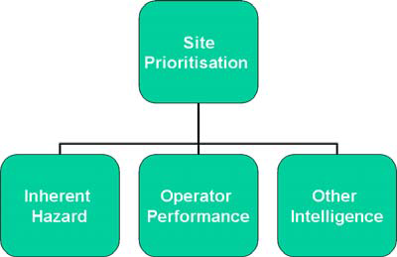
Approach to inspection
We prioritise offshore inspections in line with the principals in our strategy:
http://www.hse.gov.uk/offshore/methodology-offshore-installations.pdf
Notes:
Inspection of maintenance and asset integrity and associated software issues around safety management is a central part of HSE’s intervention strategy and a key tool in our interventions.
We operate a risk based approach to inspection, initially prioritising installations with the (1) greatest inherent hazard, but adjusting this priority after consideration of the (2) safety performance of the Operator and taking (3) other factors into account, including the professional judgement of our own Inspectors, Specialists and Engineers.
We inspect both the condition of assets and the underpinning safety management systems, including leadership, competency and workforce engagement.
But “maintenance” is a now core component of every offshore inspection, and all operators are scored on their Maintenance Management performance.

Slide 22
Lessons for Industry
Involve the workforce
Deal with major hazards, not just slips and trips
Workers must understand why they are asked to do things in a certain way
Workers can monitor at first hand if tasks are realistically designed, if procedures are being followed and if plant is decaying

Slide 23
Lessons for Industry
Relevant to every stage of the life cycle
Hardware and software systems must both be appropriately designed and maintained
Identify and act upon Key Performance indicators – manage your business
What happens on the beach is as critical as what happens offshore
Its integral to the business – not a series of initiatives

Slide 24
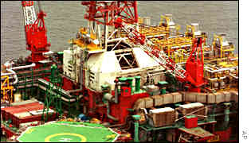
Lessons for industry?
Petrobras built the P36 Production Rig (Biggest in the world) as cheaply as they could by neglecting traditional engineering methods & standards.

Slide 25
A Press Release from Petrobras
"Petrobras has established new global benchmarks for the generation of exceptional shareholder wealth through an aggressive and innovative programme of cost cutting on its P36 production facility.

Slide 26
Conventional constraints have been successfully challenged and replaced with new paradigms appropriate to the globalised corporate market place.

Slide 27
Through an integrated network of facilitated workshops, the project has successfully rejected the established constricting and negative influences of prescriptive engineering, onerous quality requirements, and outdated concepts of inspection and client control.

Slide 28
The P36 platform shows the shape of things to come in the unregulated Global market economy of the 21st Century."

Slide 29
Lessons for Industry
Luck is not a tool for managing a major hazard business!

Slide 30
Lessons for Industry
Leadership

Slide 31
Lessons for Industry
Are you feeling lucky?

